Slide 1
Arduino Programming Things

Slide 2
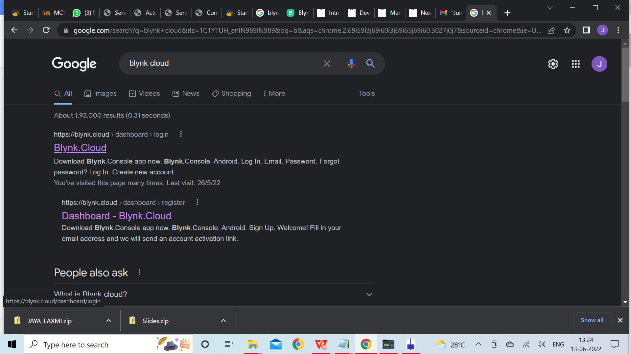
Arduino Search for Blynk on browser
Open the first link
Blynk Cloud
Notes:
Inexpensive - Arduino boards are relatively inexpensive compared to other microcontroller platforms. The least expensive version of the Arduino module can be assembled by hand, and even the pre-assembled Arduino modules cost less than $50
Cross-platform - The Arduino Software (IDE) runs on Windows, Macintosh OSX, and Linux operating systems. Most microcontroller systems are limited to Windows.
Simple, clear programming environment - The Arduino Software (IDE) is easy-to-use for beginners, yet flexible enough for advanced users to take advantage of as well. For teachers, it's conveniently based on the Processing programming environment, so students learning to program in that environment will be familiar with how the Arduino IDE works.
Open source and extensible software - The Arduino software is published as open source tools, available for extension by experienced programmers. The language can be expanded through C++ libraries, and people wanting to understand the technical details can make the leap from Arduino to the AVR C programming language on which it's based. Similarly, you can add AVR-C code directly into your Arduino programs if you want to.
Open source and extensible hardware - The plans of the Arduino boards are published under a Creative Commons license, so experienced circuit designers can make their own version of the module, extending it and improving it. Even relatively inexperienced users can build the breadboard version of the module in order to understand how it works and save money.

Slide 3
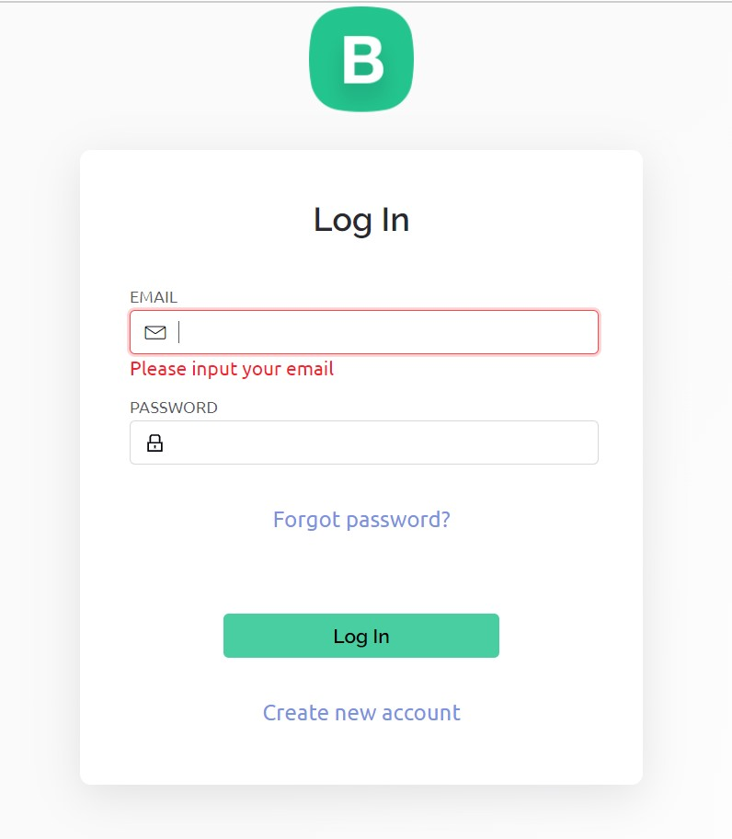
Arduino
Create new Account
Notes:
Inexpensive - Arduino boards are relatively inexpensive compared to other microcontroller platforms. The least expensive version of the Arduino module can be assembled by hand, and even the pre-assembled Arduino modules cost less than $50
Cross-platform - The Arduino Software (IDE) runs on Windows, Macintosh OSX, and Linux operating systems. Most microcontroller systems are limited to Windows.
Simple, clear programming environment - The Arduino Software (IDE) is easy-to-use for beginners, yet flexible enough for advanced users to take advantage of as well. For teachers, it's conveniently based on the Processing programming environment, so students learning to program in that environment will be familiar with how the Arduino IDE works.
Open source and extensible software - The Arduino software is published as open source tools, available for extension by experienced programmers. The language can be expanded through C++ libraries, and people wanting to understand the technical details can make the leap from Arduino to the AVR C programming language on which it's based. Similarly, you can add AVR-C code directly into your Arduino programs if you want to.
Open source and extensible hardware - The plans of the Arduino boards are published under a Creative Commons license, so experienced circuit designers can make their own version of the module, extending it and improving it. Even relatively inexperienced users can build the breadboard version of the module in order to understand how it works and save money.

Slide 4
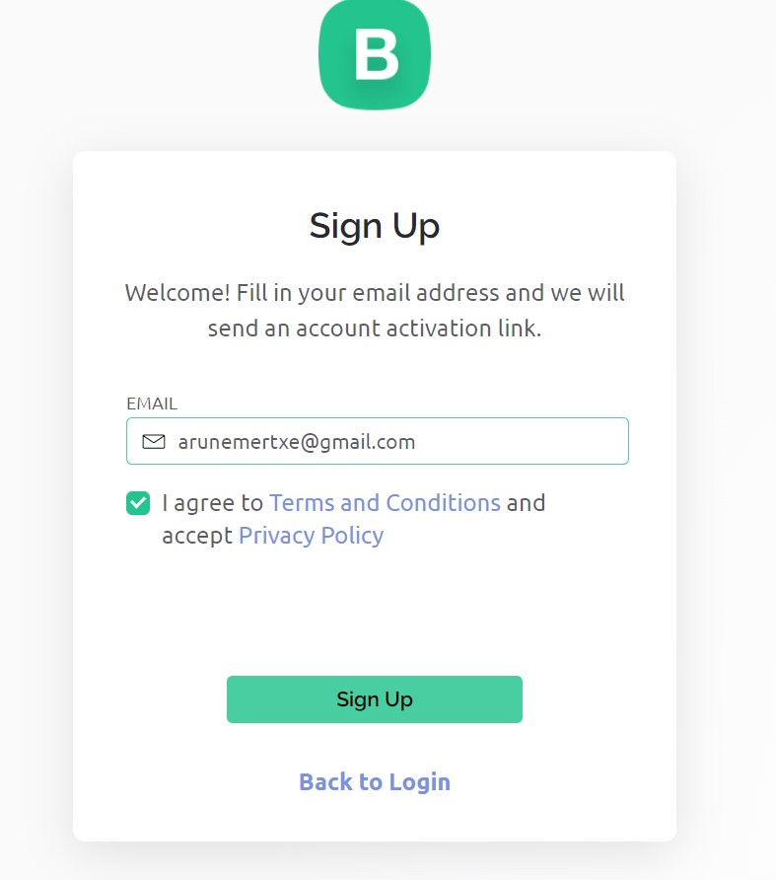
Arduino Click on the download button
Enter email id
and select i agree
***************
Sign Up
Notes:
Inexpensive - Arduino boards are relatively inexpensive compared to other microcontroller platforms. The least expensive version of the Arduino module can be assembled by hand, and even the pre-assembled Arduino modules cost less than $50
Cross-platform - The Arduino Software (IDE) runs on Windows, Macintosh OSX, and Linux operating systems. Most microcontroller systems are limited to Windows.
Simple, clear programming environment - The Arduino Software (IDE) is easy-to-use for beginners, yet flexible enough for advanced users to take advantage of as well. For teachers, it's conveniently based on the Processing programming environment, so students learning to program in that environment will be familiar with how the Arduino IDE works.
Open source and extensible software - The Arduino software is published as open source tools, available for extension by experienced programmers. The language can be expanded through C++ libraries, and people wanting to understand the technical details can make the leap from Arduino to the AVR C programming language on which it's based. Similarly, you can add AVR-C code directly into your Arduino programs if you want to.
Open source and extensible hardware - The plans of the Arduino boards are published under a Creative Commons license, so experienced circuit designers can make their own version of the module, extending it and improving it. Even relatively inexperienced users can build the breadboard version of the module in order to understand how it works and save money.

Slide 5
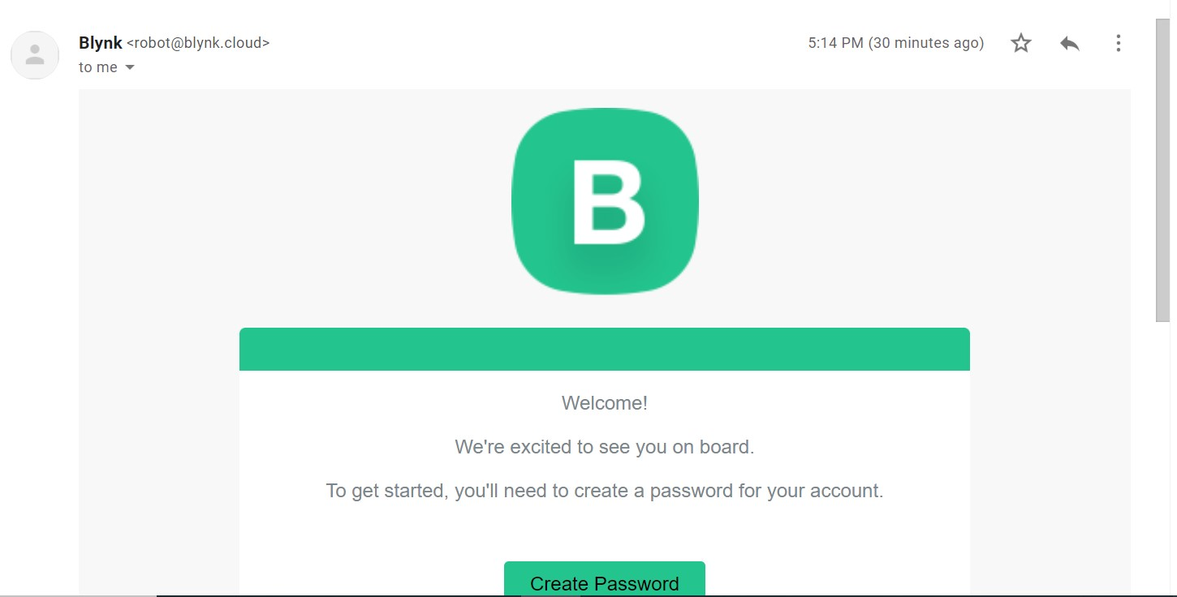
Arduino
You will recive mail in your inbox to set password for BLYNK.
Open the mail and click on the create password.
Notes:
Inexpensive - Arduino boards are relatively inexpensive compared to other microcontroller platforms. The least expensive version of the Arduino module can be assembled by hand, and even the pre-assembled Arduino modules cost less than $50
Cross-platform - The Arduino Software (IDE) runs on Windows, Macintosh OSX, and Linux operating systems. Most microcontroller systems are limited to Windows.
Simple, clear programming environment - The Arduino Software (IDE) is easy-to-use for beginners, yet flexible enough for advanced users to take advantage of as well. For teachers, it's conveniently based on the Processing programming environment, so students learning to program in that environment will be familiar with how the Arduino IDE works.
Open source and extensible software - The Arduino software is published as open source tools, available for extension by experienced programmers. The language can be expanded through C++ libraries, and people wanting to understand the technical details can make the leap from Arduino to the AVR C programming language on which it's based. Similarly, you can add AVR-C code directly into your Arduino programs if you want to.
Open source and extensible hardware - The plans of the Arduino boards are published under a Creative Commons license, so experienced circuit designers can make their own version of the module, extending it and improving it. Even relatively inexperienced users can build the breadboard version of the module in order to understand how it works and save money.

Slide 6
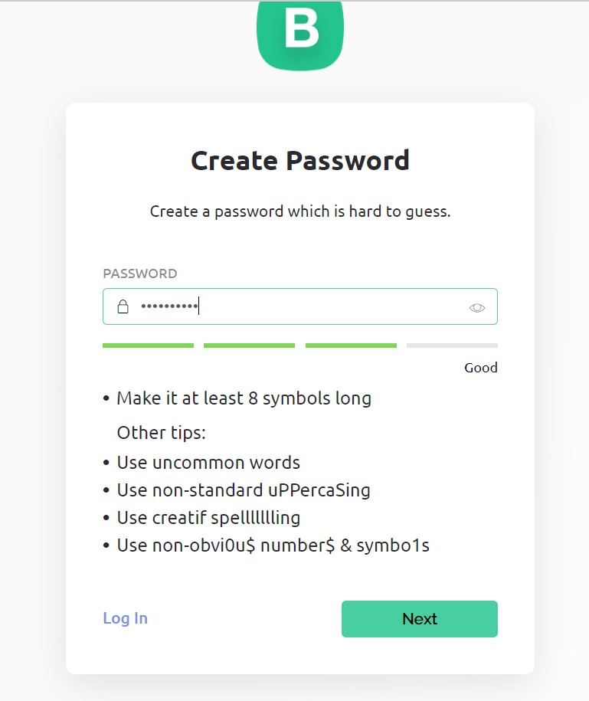
Arduino
Set password and Next
Notes:
Inexpensive - Arduino boards are relatively inexpensive compared to other microcontroller platforms. The least expensive version of the Arduino module can be assembled by hand, and even the pre-assembled Arduino modules cost less than $50
Cross-platform - The Arduino Software (IDE) runs on Windows, Macintosh OSX, and Linux operating systems. Most microcontroller systems are limited to Windows.
Simple, clear programming environment - The Arduino Software (IDE) is easy-to-use for beginners, yet flexible enough for advanced users to take advantage of as well. For teachers, it's conveniently based on the Processing programming environment, so students learning to program in that environment will be familiar with how the Arduino IDE works.
Open source and extensible software - The Arduino software is published as open source tools, available for extension by experienced programmers. The language can be expanded through C++ libraries, and people wanting to understand the technical details can make the leap from Arduino to the AVR C programming language on which it's based. Similarly, you can add AVR-C code directly into your Arduino programs if you want to.
Open source and extensible hardware - The plans of the Arduino boards are published under a Creative Commons license, so experienced circuit designers can make their own version of the module, extending it and improving it. Even relatively inexperienced users can build the breadboard version of the module in order to understand how it works and save money.

Slide 7

Arduino
Create Profile add your name
and done
Notes:
Inexpensive - Arduino boards are relatively inexpensive compared to other microcontroller platforms. The least expensive version of the Arduino module can be assembled by hand, and even the pre-assembled Arduino modules cost less than $50
Cross-platform - The Arduino Software (IDE) runs on Windows, Macintosh OSX, and Linux operating systems. Most microcontroller systems are limited to Windows.
Simple, clear programming environment - The Arduino Software (IDE) is easy-to-use for beginners, yet flexible enough for advanced users to take advantage of as well. For teachers, it's conveniently based on the Processing programming environment, so students learning to program in that environment will be familiar with how the Arduino IDE works.
Open source and extensible software - The Arduino software is published as open source tools, available for extension by experienced programmers. The language can be expanded through C++ libraries, and people wanting to understand the technical details can make the leap from Arduino to the AVR C programming language on which it's based. Similarly, you can add AVR-C code directly into your Arduino programs if you want to.
Open source and extensible hardware - The plans of the Arduino boards are published under a Creative Commons license, so experienced circuit designers can make their own version of the module, extending it and improving it. Even relatively inexperienced users can build the breadboard version of the module in order to understand how it works and save money.

Slide 8
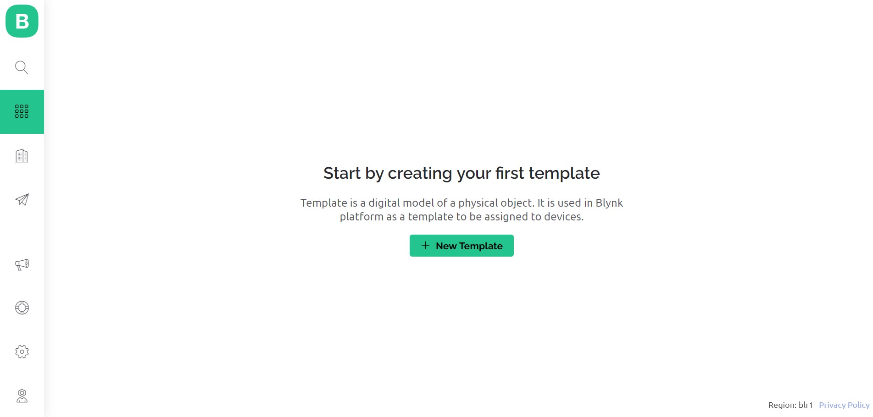
Arduino To create template
Select template icon
click on new template
Notes:
Inexpensive - Arduino boards are relatively inexpensive compared to other microcontroller platforms. The least expensive version of the Arduino module can be assembled by hand, and even the pre-assembled Arduino modules cost less than $50
Cross-platform - The Arduino Software (IDE) runs on Windows, Macintosh OSX, and Linux operating systems. Most microcontroller systems are limited to Windows.
Simple, clear programming environment - The Arduino Software (IDE) is easy-to-use for beginners, yet flexible enough for advanced users to take advantage of as well. For teachers, it's conveniently based on the Processing programming environment, so students learning to program in that environment will be familiar with how the Arduino IDE works.
Open source and extensible software - The Arduino software is published as open source tools, available for extension by experienced programmers. The language can be expanded through C++ libraries, and people wanting to understand the technical details can make the leap from Arduino to the AVR C programming language on which it's based. Similarly, you can add AVR-C code directly into your Arduino programs if you want to.
Open source and extensible hardware - The plans of the Arduino boards are published under a Creative Commons license, so experienced circuit designers can make their own version of the module, extending it and improving it. Even relatively inexperienced users can build the breadboard version of the module in order to understand how it works and save money.

Slide 9
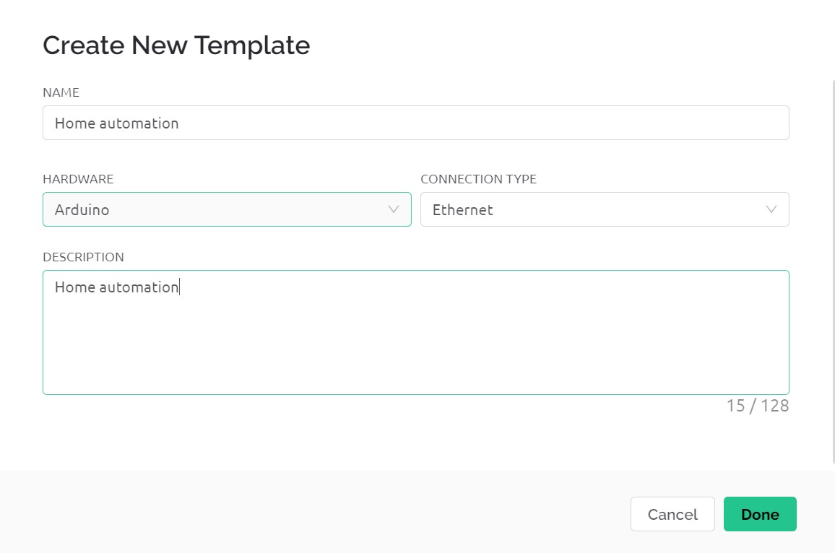
Arduino To create template
Add the template name
->home automation
Add the device name
-> Arduino
Add connection type
->Ethernet
Add description
-> ...
Notes:
Inexpensive - Arduino boards are relatively inexpensive compared to other microcontroller platforms. The least expensive version of the Arduino module can be assembled by hand, and even the pre-assembled Arduino modules cost less than $50
Cross-platform - The Arduino Software (IDE) runs on Windows, Macintosh OSX, and Linux operating systems. Most microcontroller systems are limited to Windows.
Simple, clear programming environment - The Arduino Software (IDE) is easy-to-use for beginners, yet flexible enough for advanced users to take advantage of as well. For teachers, it's conveniently based on the Processing programming environment, so students learning to program in that environment will be familiar with how the Arduino IDE works.
Open source and extensible software - The Arduino software is published as open source tools, available for extension by experienced programmers. The language can be expanded through C++ libraries, and people wanting to understand the technical details can make the leap from Arduino to the AVR C programming language on which it's based. Similarly, you can add AVR-C code directly into your Arduino programs if you want to.
Open source and extensible hardware - The plans of the Arduino boards are published under a Creative Commons license, so experienced circuit designers can make their own version of the module, extending it and improving it. Even relatively inexperienced users can build the breadboard version of the module in order to understand how it works and save money.

Slide 10
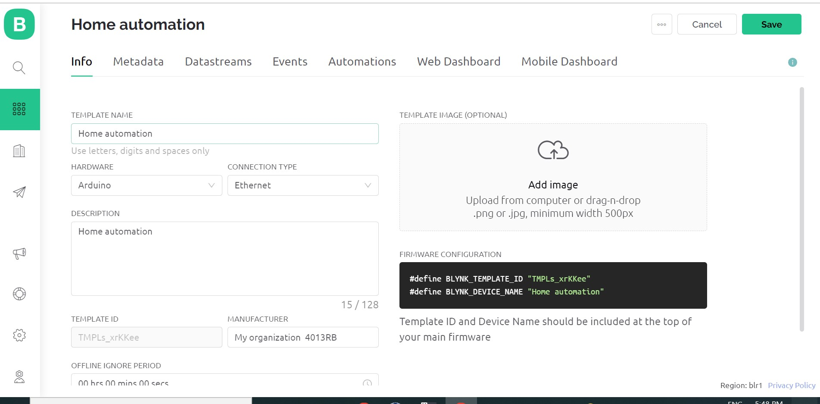
Arduino To create template
Template created
Notes:
Inexpensive - Arduino boards are relatively inexpensive compared to other microcontroller platforms. The least expensive version of the Arduino module can be assembled by hand, and even the pre-assembled Arduino modules cost less than $50
Cross-platform - The Arduino Software (IDE) runs on Windows, Macintosh OSX, and Linux operating systems. Most microcontroller systems are limited to Windows.
Simple, clear programming environment - The Arduino Software (IDE) is easy-to-use for beginners, yet flexible enough for advanced users to take advantage of as well. For teachers, it's conveniently based on the Processing programming environment, so students learning to program in that environment will be familiar with how the Arduino IDE works.
Open source and extensible software - The Arduino software is published as open source tools, available for extension by experienced programmers. The language can be expanded through C++ libraries, and people wanting to understand the technical details can make the leap from Arduino to the AVR C programming language on which it's based. Similarly, you can add AVR-C code directly into your Arduino programs if you want to.
Open source and extensible hardware - The plans of the Arduino boards are published under a Creative Commons license, so experienced circuit designers can make their own version of the module, extending it and improving it. Even relatively inexperienced users can build the breadboard version of the module in order to understand how it works and save money.

Slide 11
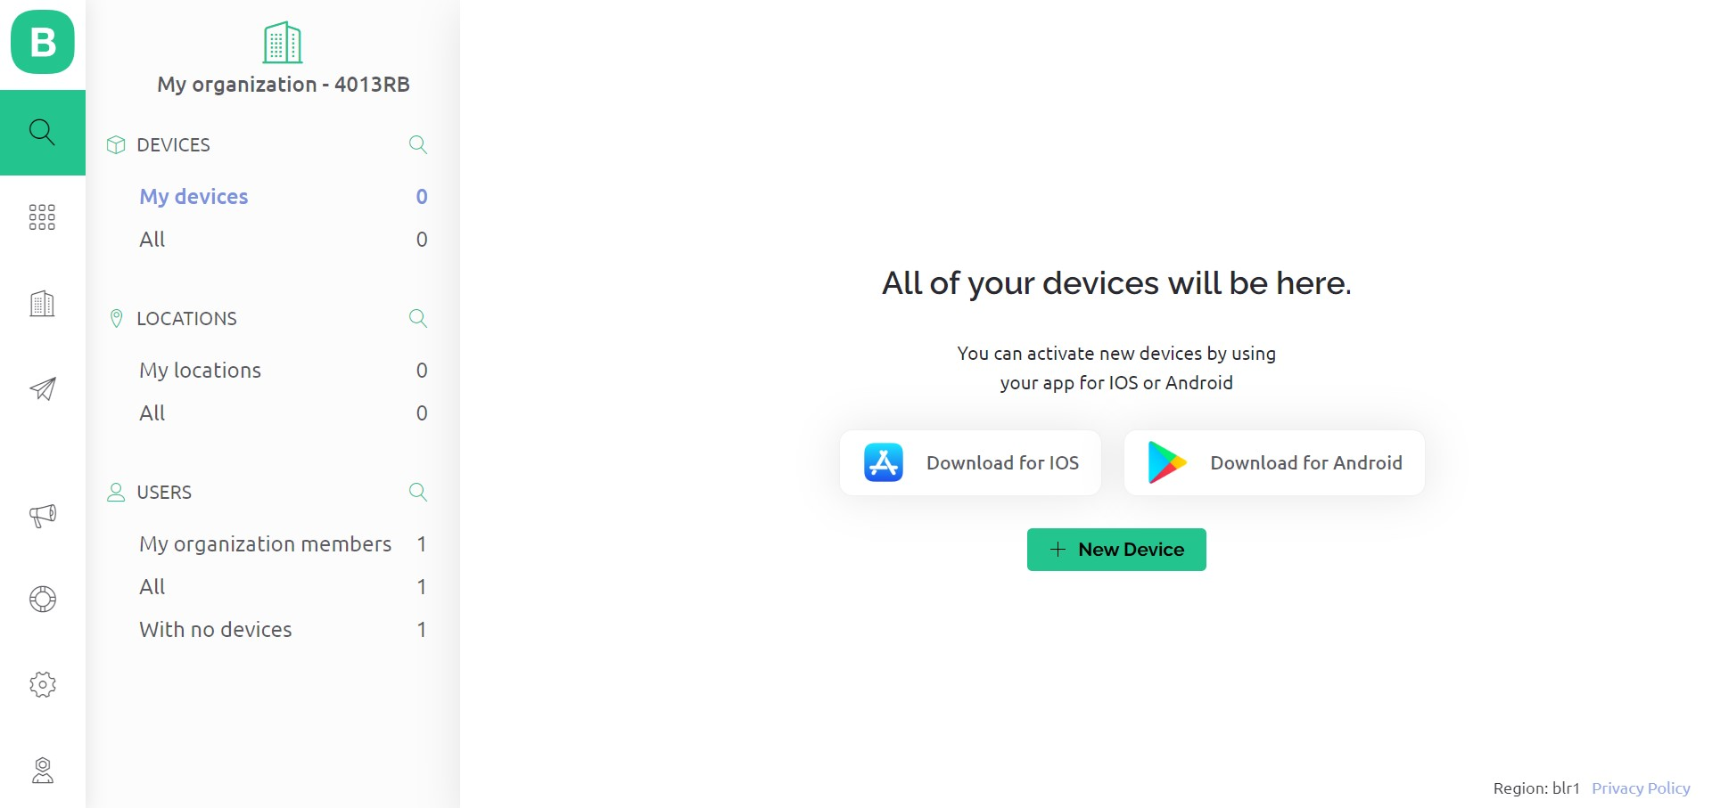
Arduino To add new device
Select search
option
Add New Device
Notes:
Inexpensive - Arduino boards are relatively inexpensive compared to other microcontroller platforms. The least expensive version of the Arduino module can be assembled by hand, and even the pre-assembled Arduino modules cost less than $50
Cross-platform - The Arduino Software (IDE) runs on Windows, Macintosh OSX, and Linux operating systems. Most microcontroller systems are limited to Windows.
Simple, clear programming environment - The Arduino Software (IDE) is easy-to-use for beginners, yet flexible enough for advanced users to take advantage of as well. For teachers, it's conveniently based on the Processing programming environment, so students learning to program in that environment will be familiar with how the Arduino IDE works.
Open source and extensible software - The Arduino software is published as open source tools, available for extension by experienced programmers. The language can be expanded through C++ libraries, and people wanting to understand the technical details can make the leap from Arduino to the AVR C programming language on which it's based. Similarly, you can add AVR-C code directly into your Arduino programs if you want to.
Open source and extensible hardware - The plans of the Arduino boards are published under a Creative Commons license, so experienced circuit designers can make their own version of the module, extending it and improving it. Even relatively inexperienced users can build the breadboard version of the module in order to understand how it works and save money.

Slide 12
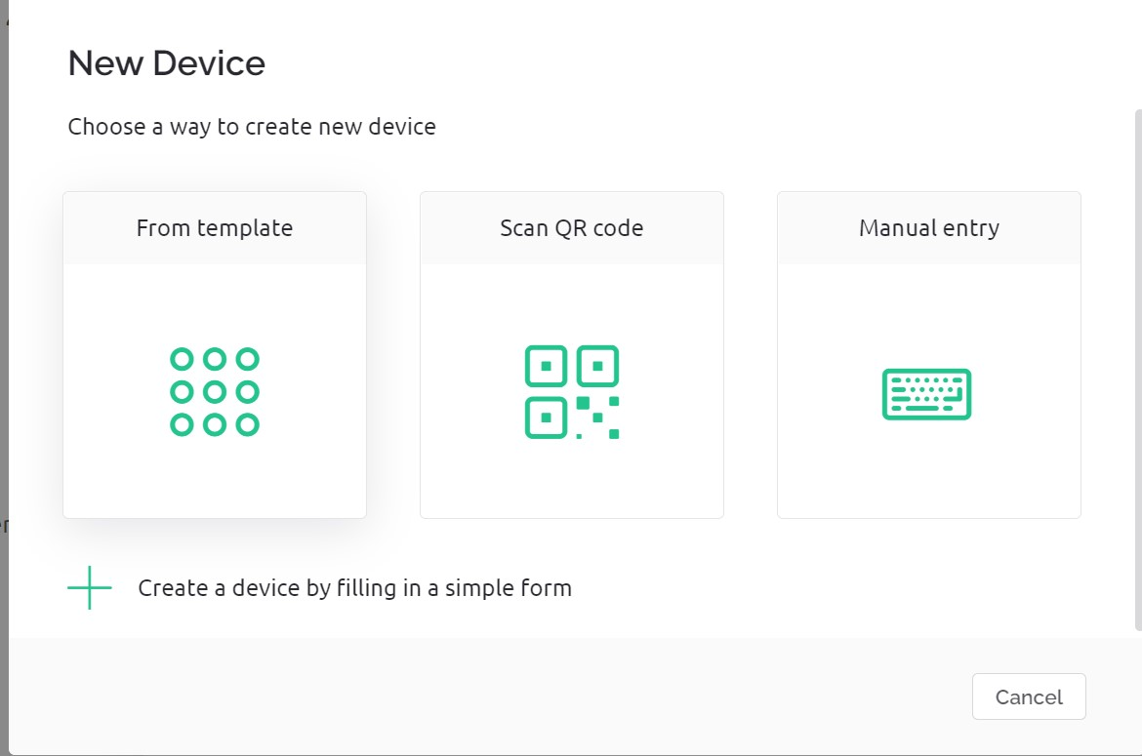
Arduino To add new device
select option from
template
Notes:
Inexpensive - Arduino boards are relatively inexpensive compared to other microcontroller platforms. The least expensive version of the Arduino module can be assembled by hand, and even the pre-assembled Arduino modules cost less than $50
Cross-platform - The Arduino Software (IDE) runs on Windows, Macintosh OSX, and Linux operating systems. Most microcontroller systems are limited to Windows.
Simple, clear programming environment - The Arduino Software (IDE) is easy-to-use for beginners, yet flexible enough for advanced users to take advantage of as well. For teachers, it's conveniently based on the Processing programming environment, so students learning to program in that environment will be familiar with how the Arduino IDE works.
Open source and extensible software - The Arduino software is published as open source tools, available for extension by experienced programmers. The language can be expanded through C++ libraries, and people wanting to understand the technical details can make the leap from Arduino to the AVR C programming language on which it's based. Similarly, you can add AVR-C code directly into your Arduino programs if you want to.
Open source and extensible hardware - The plans of the Arduino boards are published under a Creative Commons license, so experienced circuit designers can make their own version of the module, extending it and improving it. Even relatively inexperienced users can build the breadboard version of the module in order to understand how it works and save money.

Slide 13
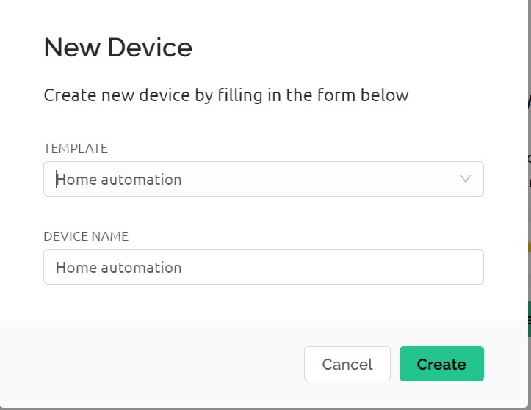
Arduino To add new device
Select the template
and add the device name
click on create
Notes:
Inexpensive - Arduino boards are relatively inexpensive compared to other microcontroller platforms. The least expensive version of the Arduino module can be assembled by hand, and even the pre-assembled Arduino modules cost less than $50
Cross-platform - The Arduino Software (IDE) runs on Windows, Macintosh OSX, and Linux operating systems. Most microcontroller systems are limited to Windows.
Simple, clear programming environment - The Arduino Software (IDE) is easy-to-use for beginners, yet flexible enough for advanced users to take advantage of as well. For teachers, it's conveniently based on the Processing programming environment, so students learning to program in that environment will be familiar with how the Arduino IDE works.
Open source and extensible software - The Arduino software is published as open source tools, available for extension by experienced programmers. The language can be expanded through C++ libraries, and people wanting to understand the technical details can make the leap from Arduino to the AVR C programming language on which it's based. Similarly, you can add AVR-C code directly into your Arduino programs if you want to.
Open source and extensible hardware - The plans of the Arduino boards are published under a Creative Commons license, so experienced circuit designers can make their own version of the module, extending it and improving it. Even relatively inexperienced users can build the breadboard version of the module in order to understand how it works and save money.

Slide 14
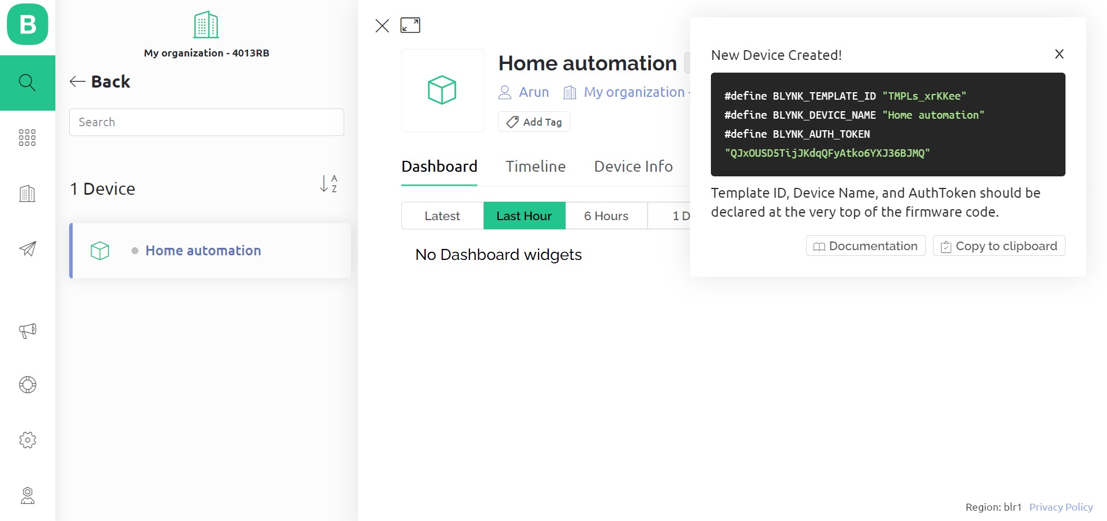
Arduino
device is added
copy the template id , device name,auth token , need it in further coding
Notes:
Inexpensive - Arduino boards are relatively inexpensive compared to other microcontroller platforms. The least expensive version of the Arduino module can be assembled by hand, and even the pre-assembled Arduino modules cost less than $50
Cross-platform - The Arduino Software (IDE) runs on Windows, Macintosh OSX, and Linux operating systems. Most microcontroller systems are limited to Windows.
Simple, clear programming environment - The Arduino Software (IDE) is easy-to-use for beginners, yet flexible enough for advanced users to take advantage of as well. For teachers, it's conveniently based on the Processing programming environment, so students learning to program in that environment will be familiar with how the Arduino IDE works.
Open source and extensible software - The Arduino software is published as open source tools, available for extension by experienced programmers. The language can be expanded through C++ libraries, and people wanting to understand the technical details can make the leap from Arduino to the AVR C programming language on which it's based. Similarly, you can add AVR-C code directly into your Arduino programs if you want to.
Open source and extensible hardware - The plans of the Arduino boards are published under a Creative Commons license, so experienced circuit designers can make their own version of the module, extending it and improving it. Even relatively inexperienced users can build the breadboard version of the module in order to understand how it works and save money.

Slide 15
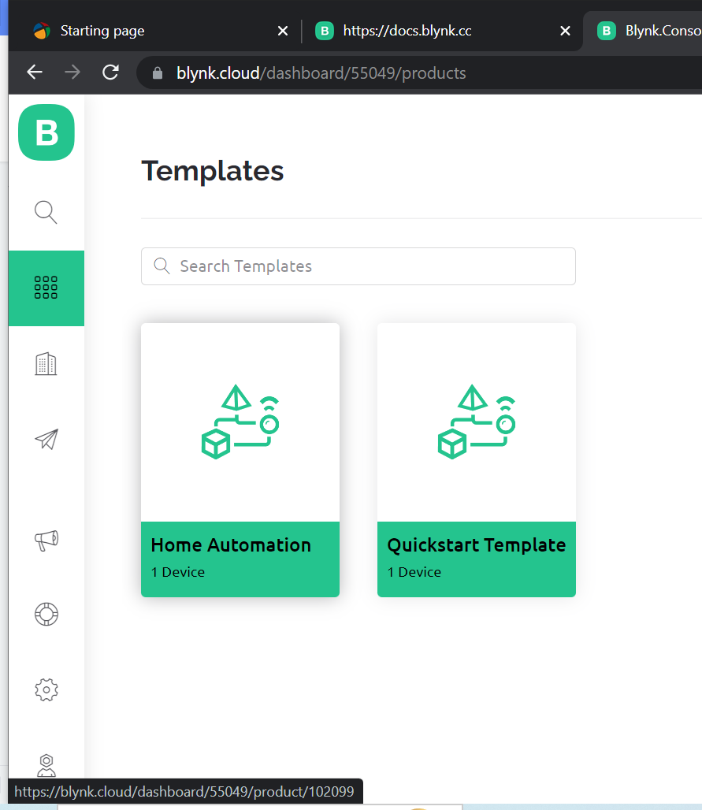
Arduino To add datstream
Select the template option.
Select created “Home Automation”
template.
Notes:
Inexpensive - Arduino boards are relatively inexpensive compared to other microcontroller platforms. The least expensive version of the Arduino module can be assembled by hand, and even the pre-assembled Arduino modules cost less than $50
Cross-platform - The Arduino Software (IDE) runs on Windows, Macintosh OSX, and Linux operating systems. Most microcontroller systems are limited to Windows.
Simple, clear programming environment - The Arduino Software (IDE) is easy-to-use for beginners, yet flexible enough for advanced users to take advantage of as well. For teachers, it's conveniently based on the Processing programming environment, so students learning to program in that environment will be familiar with how the Arduino IDE works.
Open source and extensible software - The Arduino software is published as open source tools, available for extension by experienced programmers. The language can be expanded through C++ libraries, and people wanting to understand the technical details can make the leap from Arduino to the AVR C programming language on which it's based. Similarly, you can add AVR-C code directly into your Arduino programs if you want to.
Open source and extensible hardware - The plans of the Arduino boards are published under a Creative Commons license, so experienced circuit designers can make their own version of the module, extending it and improving it. Even relatively inexperienced users can build the breadboard version of the module in order to understand how it works and save money.

Slide 16
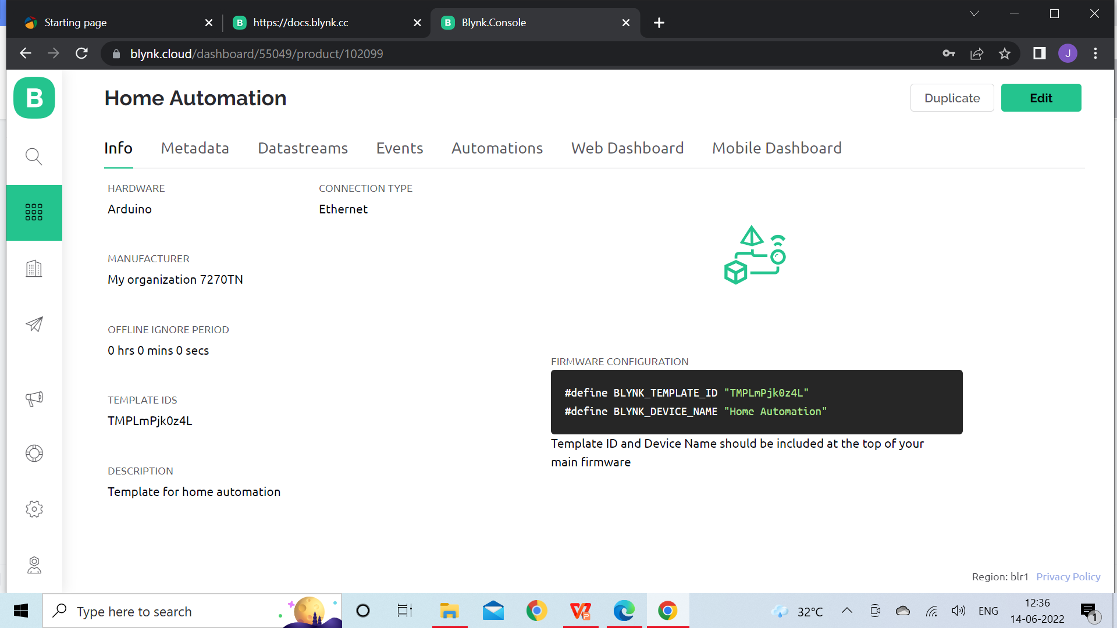
Arduino To add data stream
click on edit
Notes:
Inexpensive - Arduino boards are relatively inexpensive compared to other microcontroller platforms. The least expensive version of the Arduino module can be assembled by hand, and even the pre-assembled Arduino modules cost less than $50
Cross-platform - The Arduino Software (IDE) runs on Windows, Macintosh OSX, and Linux operating systems. Most microcontroller systems are limited to Windows.
Simple, clear programming environment - The Arduino Software (IDE) is easy-to-use for beginners, yet flexible enough for advanced users to take advantage of as well. For teachers, it's conveniently based on the Processing programming environment, so students learning to program in that environment will be familiar with how the Arduino IDE works.
Open source and extensible software - The Arduino software is published as open source tools, available for extension by experienced programmers. The language can be expanded through C++ libraries, and people wanting to understand the technical details can make the leap from Arduino to the AVR C programming language on which it's based. Similarly, you can add AVR-C code directly into your Arduino programs if you want to.
Open source and extensible hardware - The plans of the Arduino boards are published under a Creative Commons license, so experienced circuit designers can make their own version of the module, extending it and improving it. Even relatively inexperienced users can build the breadboard version of the module in order to understand how it works and save money.

Slide 17
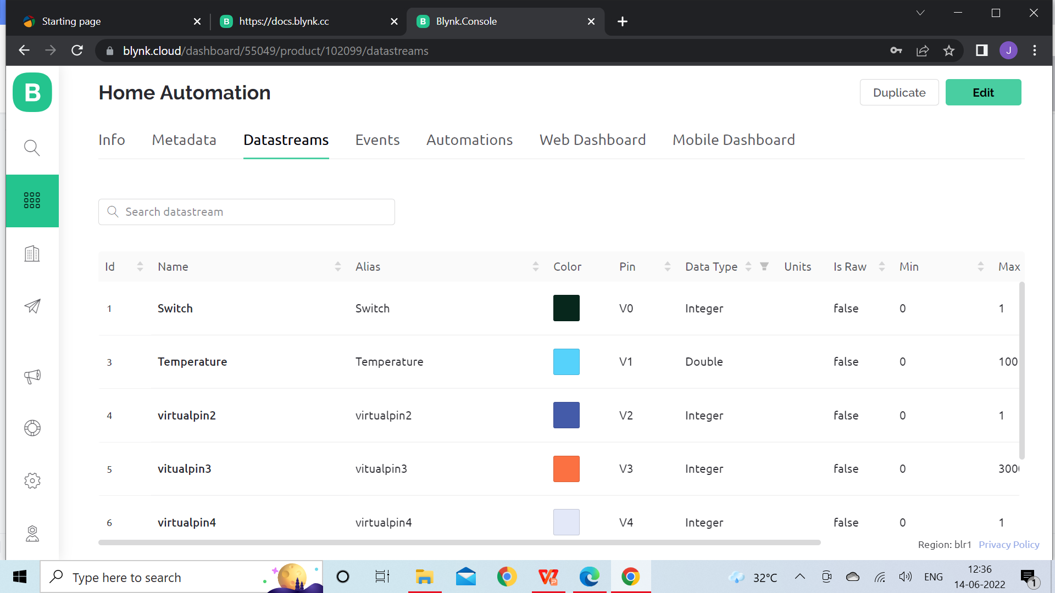
Arduino To add datastream
Select the Datastreams
Notes:
Inexpensive - Arduino boards are relatively inexpensive compared to other microcontroller platforms. The least expensive version of the Arduino module can be assembled by hand, and even the pre-assembled Arduino modules cost less than $50
Cross-platform - The Arduino Software (IDE) runs on Windows, Macintosh OSX, and Linux operating systems. Most microcontroller systems are limited to Windows.
Simple, clear programming environment - The Arduino Software (IDE) is easy-to-use for beginners, yet flexible enough for advanced users to take advantage of as well. For teachers, it's conveniently based on the Processing programming environment, so students learning to program in that environment will be familiar with how the Arduino IDE works.
Open source and extensible software - The Arduino software is published as open source tools, available for extension by experienced programmers. The language can be expanded through C++ libraries, and people wanting to understand the technical details can make the leap from Arduino to the AVR C programming language on which it's based. Similarly, you can add AVR-C code directly into your Arduino programs if you want to.
Open source and extensible hardware - The plans of the Arduino boards are published under a Creative Commons license, so experienced circuit designers can make their own version of the module, extending it and improving it. Even relatively inexperienced users can build the breadboard version of the module in order to understand how it works and save money.

Slide 18
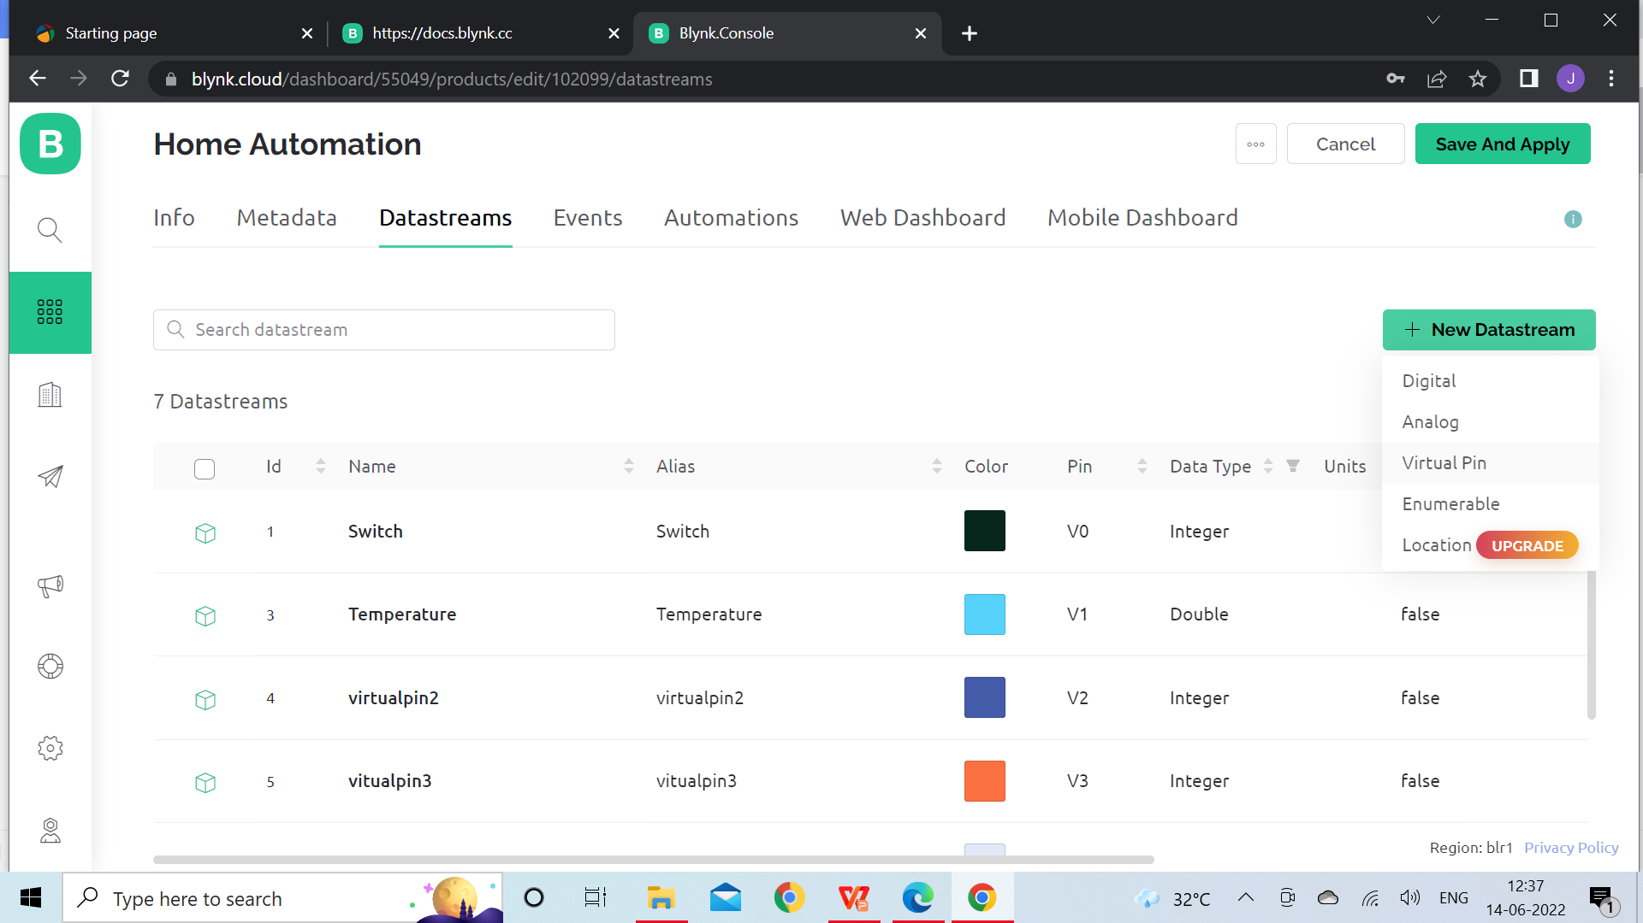
Arduino To add data stream
Click on
New Datastream
Select Virtual Pin
Notes:
Inexpensive - Arduino boards are relatively inexpensive compared to other microcontroller platforms. The least expensive version of the Arduino module can be assembled by hand, and even the pre-assembled Arduino modules cost less than $50
Cross-platform - The Arduino Software (IDE) runs on Windows, Macintosh OSX, and Linux operating systems. Most microcontroller systems are limited to Windows.
Simple, clear programming environment - The Arduino Software (IDE) is easy-to-use for beginners, yet flexible enough for advanced users to take advantage of as well. For teachers, it's conveniently based on the Processing programming environment, so students learning to program in that environment will be familiar with how the Arduino IDE works.
Open source and extensible software - The Arduino software is published as open source tools, available for extension by experienced programmers. The language can be expanded through C++ libraries, and people wanting to understand the technical details can make the leap from Arduino to the AVR C programming language on which it's based. Similarly, you can add AVR-C code directly into your Arduino programs if you want to.
Open source and extensible hardware - The plans of the Arduino boards are published under a Creative Commons license, so experienced circuit designers can make their own version of the module, extending it and improving it. Even relatively inexperienced users can build the breadboard version of the module in order to understand how it works and save money.

Slide 19
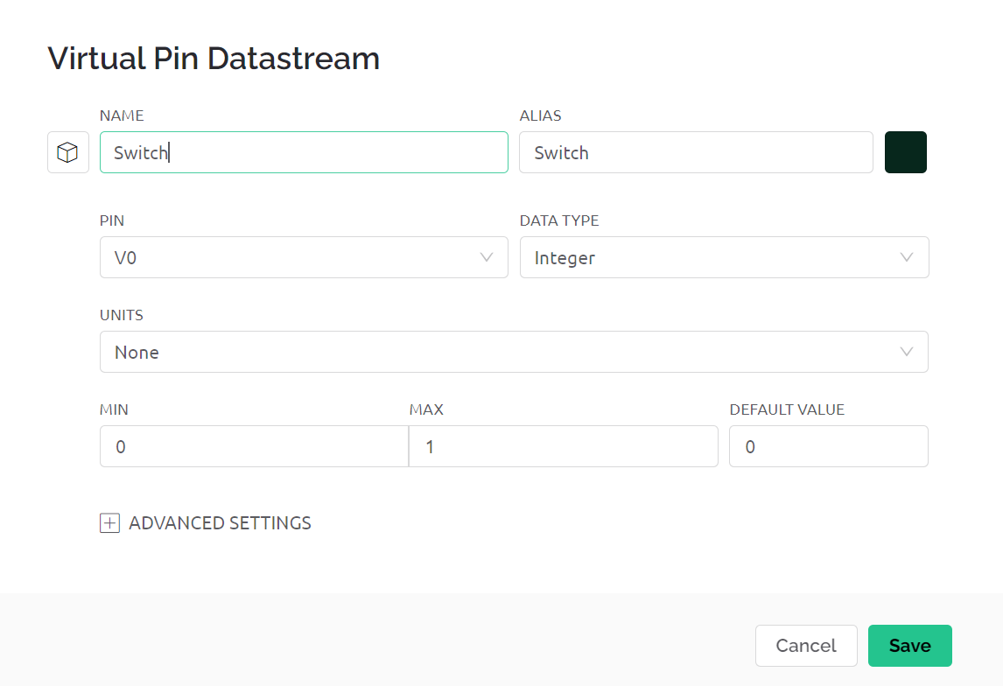
Arduino To add data stream
Add NAME
- Switch
Add PIN
- V0
And click on save
Notes:
Inexpensive - Arduino boards are relatively inexpensive compared to other microcontroller platforms. The least expensive version of the Arduino module can be assembled by hand, and even the pre-assembled Arduino modules cost less than $50
Cross-platform - The Arduino Software (IDE) runs on Windows, Macintosh OSX, and Linux operating systems. Most microcontroller systems are limited to Windows.
Simple, clear programming environment - The Arduino Software (IDE) is easy-to-use for beginners, yet flexible enough for advanced users to take advantage of as well. For teachers, it's conveniently based on the Processing programming environment, so students learning to program in that environment will be familiar with how the Arduino IDE works.
Open source and extensible software - The Arduino software is published as open source tools, available for extension by experienced programmers. The language can be expanded through C++ libraries, and people wanting to understand the technical details can make the leap from Arduino to the AVR C programming language on which it's based. Similarly, you can add AVR-C code directly into your Arduino programs if you want to.
Open source and extensible hardware - The plans of the Arduino boards are published under a Creative Commons license, so experienced circuit designers can make their own version of the module, extending it and improving it. Even relatively inexperienced users can build the breadboard version of the module in order to understand how it works and save money.

Slide 20
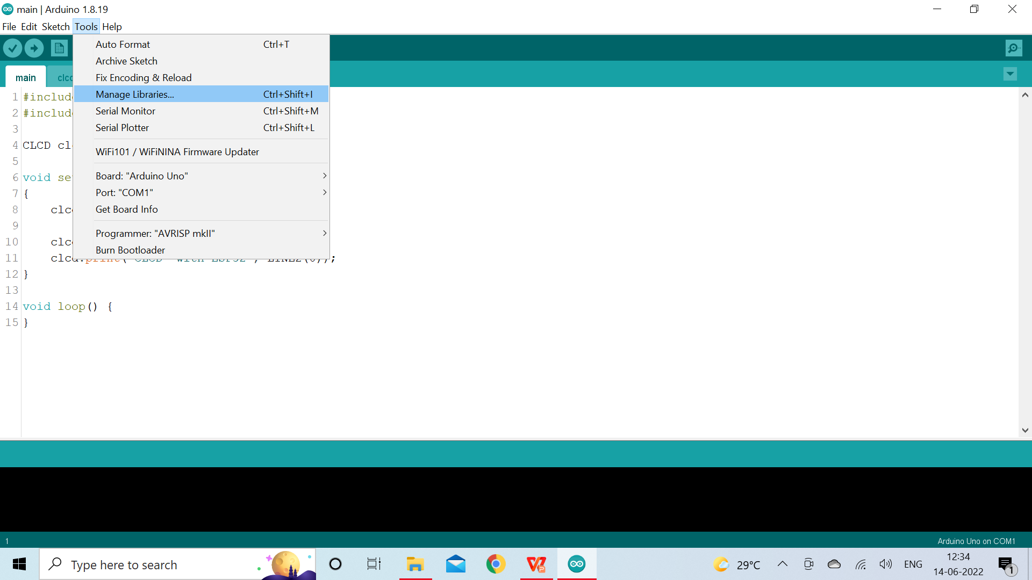
Arduino coding for BLYNK
Open arduino ide
Go to tools and select Manage Libraries .
Notes:
Inexpensive - Arduino boards are relatively inexpensive compared to other microcontroller platforms. The least expensive version of the Arduino module can be assembled by hand, and even the pre-assembled Arduino modules cost less than $50
Cross-platform - The Arduino Software (IDE) runs on Windows, Macintosh OSX, and Linux operating systems. Most microcontroller systems are limited to Windows.
Simple, clear programming environment - The Arduino Software (IDE) is easy-to-use for beginners, yet flexible enough for advanced users to take advantage of as well. For teachers, it's conveniently based on the Processing programming environment, so students learning to program in that environment will be familiar with how the Arduino IDE works.
Open source and extensible software - The Arduino software is published as open source tools, available for extension by experienced programmers. The language can be expanded through C++ libraries, and people wanting to understand the technical details can make the leap from Arduino to the AVR C programming language on which it's based. Similarly, you can add AVR-C code directly into your Arduino programs if you want to.
Open source and extensible hardware - The plans of the Arduino boards are published under a Creative Commons license, so experienced circuit designers can make their own version of the module, extending it and improving it. Even relatively inexperienced users can build the breadboard version of the module in order to understand how it works and save money.

Slide 21
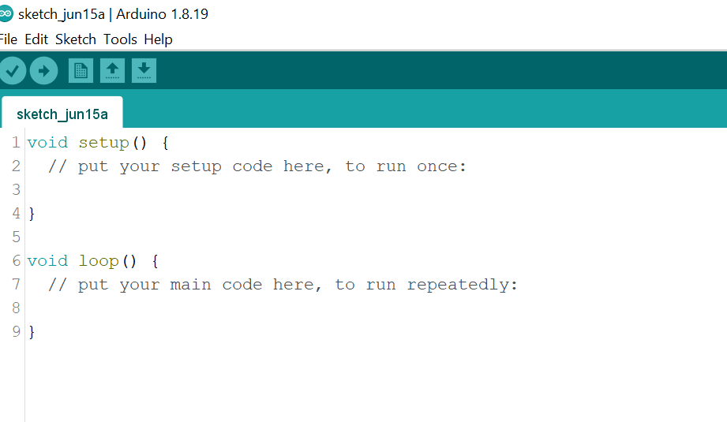
Arduino coding for BLYNK
Open New Scketch.
Notes:
Inexpensive - Arduino boards are relatively inexpensive compared to other microcontroller platforms. The least expensive version of the Arduino module can be assembled by hand, and even the pre-assembled Arduino modules cost less than $50
Cross-platform - The Arduino Software (IDE) runs on Windows, Macintosh OSX, and Linux operating systems. Most microcontroller systems are limited to Windows.
Simple, clear programming environment - The Arduino Software (IDE) is easy-to-use for beginners, yet flexible enough for advanced users to take advantage of as well. For teachers, it's conveniently based on the Processing programming environment, so students learning to program in that environment will be familiar with how the Arduino IDE works.
Open source and extensible software - The Arduino software is published as open source tools, available for extension by experienced programmers. The language can be expanded through C++ libraries, and people wanting to understand the technical details can make the leap from Arduino to the AVR C programming language on which it's based. Similarly, you can add AVR-C code directly into your Arduino programs if you want to.
Open source and extensible hardware - The plans of the Arduino boards are published under a Creative Commons license, so experienced circuit designers can make their own version of the module, extending it and improving it. Even relatively inexperienced users can build the breadboard version of the module in order to understand how it works and save money.

Slide 22
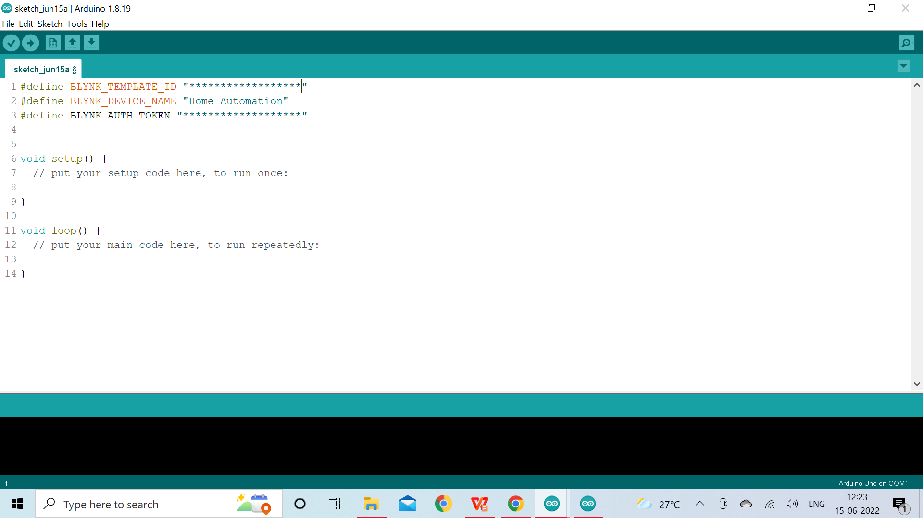
Arduino coding for BLYNK
Paste the template_id, auth token, device_name copied from Blynk console
Notes:
Inexpensive - Arduino boards are relatively inexpensive compared to other microcontroller platforms. The least expensive version of the Arduino module can be assembled by hand, and even the pre-assembled Arduino modules cost less than $50
Cross-platform - The Arduino Software (IDE) runs on Windows, Macintosh OSX, and Linux operating systems. Most microcontroller systems are limited to Windows.
Simple, clear programming environment - The Arduino Software (IDE) is easy-to-use for beginners, yet flexible enough for advanced users to take advantage of as well. For teachers, it's conveniently based on the Processing programming environment, so students learning to program in that environment will be familiar with how the Arduino IDE works.
Open source and extensible software - The Arduino software is published as open source tools, available for extension by experienced programmers. The language can be expanded through C++ libraries, and people wanting to understand the technical details can make the leap from Arduino to the AVR C programming language on which it's based. Similarly, you can add AVR-C code directly into your Arduino programs if you want to.
Open source and extensible hardware - The plans of the Arduino boards are published under a Creative Commons license, so experienced circuit designers can make their own version of the module, extending it and improving it. Even relatively inexperienced users can build the breadboard version of the module in order to understand how it works and save money.

Slide 23
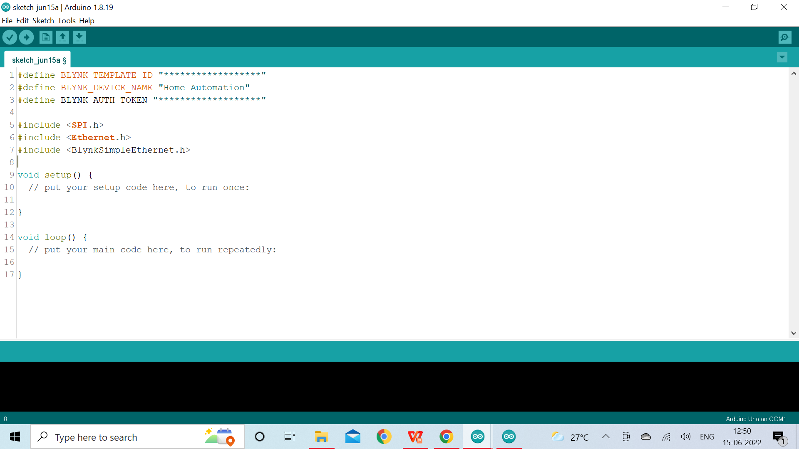
Arduino coding for BLYNK
Include SPI.h, Ethernet.h,
BlynkSimpleEthernet.h library
to enablish connect bettween
arduino and ethernet Sheild
Notes:
Inexpensive - Arduino boards are relatively inexpensive compared to other microcontroller platforms. The least expensive version of the Arduino module can be assembled by hand, and even the pre-assembled Arduino modules cost less than $50
Cross-platform - The Arduino Software (IDE) runs on Windows, Macintosh OSX, and Linux operating systems. Most microcontroller systems are limited to Windows.
Simple, clear programming environment - The Arduino Software (IDE) is easy-to-use for beginners, yet flexible enough for advanced users to take advantage of as well. For teachers, it's conveniently based on the Processing programming environment, so students learning to program in that environment will be familiar with how the Arduino IDE works.
Open source and extensible software - The Arduino software is published as open source tools, available for extension by experienced programmers. The language can be expanded through C++ libraries, and people wanting to understand the technical details can make the leap from Arduino to the AVR C programming language on which it's based. Similarly, you can add AVR-C code directly into your Arduino programs if you want to.
Open source and extensible hardware - The plans of the Arduino boards are published under a Creative Commons license, so experienced circuit designers can make their own version of the module, extending it and improving it. Even relatively inexperienced users can build the breadboard version of the module in order to understand how it works and save money.

Slide 24
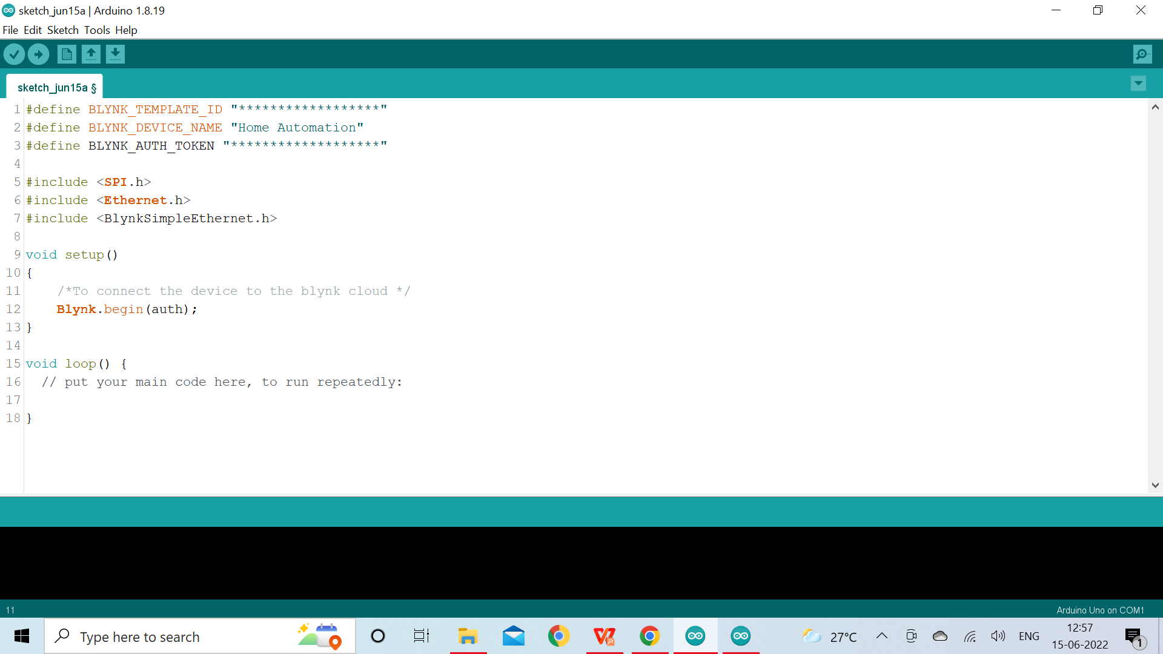
Arduino coding for BLYNK
Call Blynk.begin(auth); in
the setup function
To connect the device to the Blynk
cloud
Notes:
Inexpensive - Arduino boards are relatively inexpensive compared to other microcontroller platforms. The least expensive version of the Arduino module can be assembled by hand, and even the pre-assembled Arduino modules cost less than $50
Cross-platform - The Arduino Software (IDE) runs on Windows, Macintosh OSX, and Linux operating systems. Most microcontroller systems are limited to Windows.
Simple, clear programming environment - The Arduino Software (IDE) is easy-to-use for beginners, yet flexible enough for advanced users to take advantage of as well. For teachers, it's conveniently based on the Processing programming environment, so students learning to program in that environment will be familiar with how the Arduino IDE works.
Open source and extensible software - The Arduino software is published as open source tools, available for extension by experienced programmers. The language can be expanded through C++ libraries, and people wanting to understand the technical details can make the leap from Arduino to the AVR C programming language on which it's based. Similarly, you can add AVR-C code directly into your Arduino programs if you want to.
Open source and extensible hardware - The plans of the Arduino boards are published under a Creative Commons license, so experienced circuit designers can make their own version of the module, extending it and improving it. Even relatively inexperienced users can build the breadboard version of the module in order to understand how it works and save money.

Slide 25
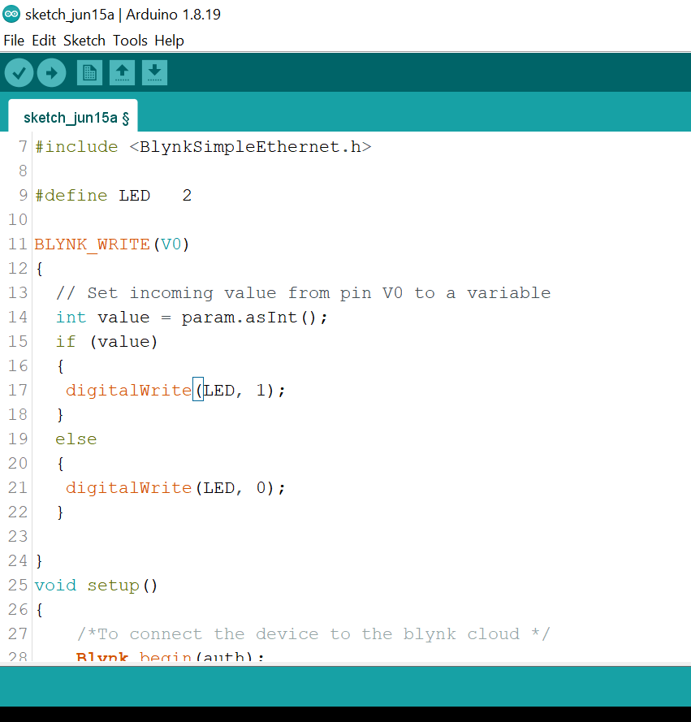
Arduino coding for BLYNK
Define LED as 2
To read the value from vitual pin
V0.
Based V0 controling the state of
LED.
Notes:
Inexpensive - Arduino boards are relatively inexpensive compared to other microcontroller platforms. The least expensive version of the Arduino module can be assembled by hand, and even the pre-assembled Arduino modules cost less than $50
Cross-platform - The Arduino Software (IDE) runs on Windows, Macintosh OSX, and Linux operating systems. Most microcontroller systems are limited to Windows.
Simple, clear programming environment - The Arduino Software (IDE) is easy-to-use for beginners, yet flexible enough for advanced users to take advantage of as well. For teachers, it's conveniently based on the Processing programming environment, so students learning to program in that environment will be familiar with how the Arduino IDE works.
Open source and extensible software - The Arduino software is published as open source tools, available for extension by experienced programmers. The language can be expanded through C++ libraries, and people wanting to understand the technical details can make the leap from Arduino to the AVR C programming language on which it's based. Similarly, you can add AVR-C code directly into your Arduino programs if you want to.
Open source and extensible hardware - The plans of the Arduino boards are published under a Creative Commons license, so experienced circuit designers can make their own version of the module, extending it and improving it. Even relatively inexperienced users can build the breadboard version of the module in order to understand how it works and save money.

Slide 26
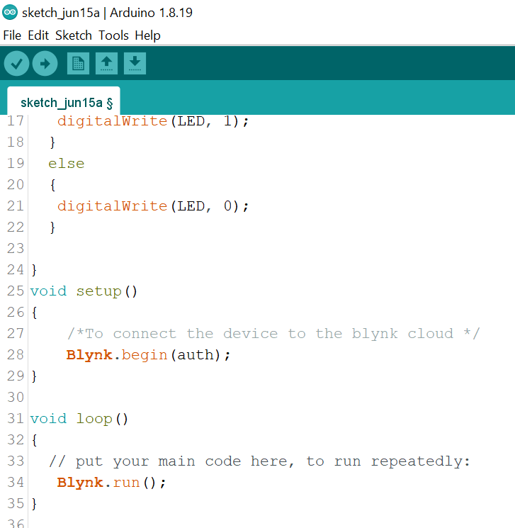
Arduino coding for BLYNK
Call Blynk.run() in loop()
Notes:
Inexpensive - Arduino boards are relatively inexpensive compared to other microcontroller platforms. The least expensive version of the Arduino module can be assembled by hand, and even the pre-assembled Arduino modules cost less than $50
Cross-platform - The Arduino Software (IDE) runs on Windows, Macintosh OSX, and Linux operating systems. Most microcontroller systems are limited to Windows.
Simple, clear programming environment - The Arduino Software (IDE) is easy-to-use for beginners, yet flexible enough for advanced users to take advantage of as well. For teachers, it's conveniently based on the Processing programming environment, so students learning to program in that environment will be familiar with how the Arduino IDE works.
Open source and extensible software - The Arduino software is published as open source tools, available for extension by experienced programmers. The language can be expanded through C++ libraries, and people wanting to understand the technical details can make the leap from Arduino to the AVR C programming language on which it's based. Similarly, you can add AVR-C code directly into your Arduino programs if you want to.
Open source and extensible hardware - The plans of the Arduino boards are published under a Creative Commons license, so experienced circuit designers can make their own version of the module, extending it and improving it. Even relatively inexperienced users can build the breadboard version of the module in order to understand how it works and save money.

Slide 27
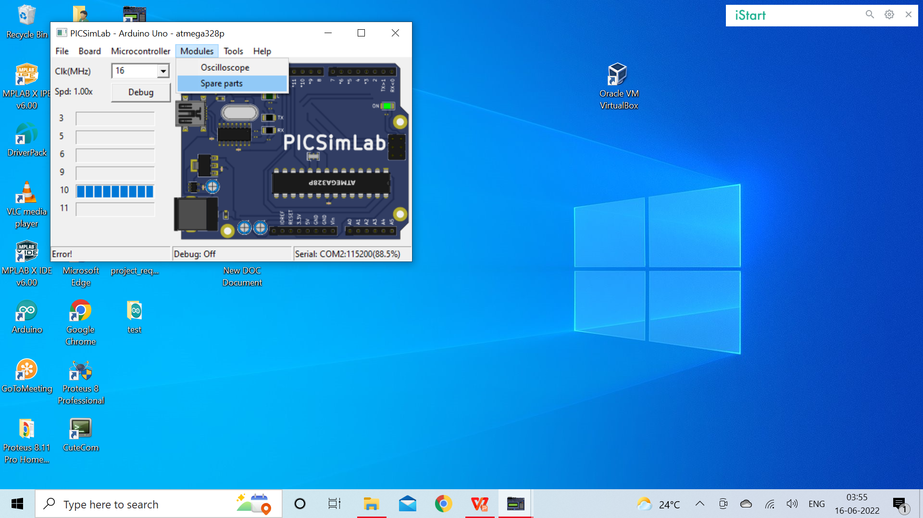
Arduino Simulation
Open picsimlab and go to tools select spare parts
Notes:
Inexpensive - Arduino boards are relatively inexpensive compared to other microcontroller platforms. The least expensive version of the Arduino module can be assembled by hand, and even the pre-assembled Arduino modules cost less than $50
Cross-platform - The Arduino Software (IDE) runs on Windows, Macintosh OSX, and Linux operating systems. Most microcontroller systems are limited to Windows.
Simple, clear programming environment - The Arduino Software (IDE) is easy-to-use for beginners, yet flexible enough for advanced users to take advantage of as well. For teachers, it's conveniently based on the Processing programming environment, so students learning to program in that environment will be familiar with how the Arduino IDE works.
Open source and extensible software - The Arduino software is published as open source tools, available for extension by experienced programmers. The language can be expanded through C++ libraries, and people wanting to understand the technical details can make the leap from Arduino to the AVR C programming language on which it's based. Similarly, you can add AVR-C code directly into your Arduino programs if you want to.
Open source and extensible hardware - The plans of the Arduino boards are published under a Creative Commons license, so experienced circuit designers can make their own version of the module, extending it and improving it. Even relatively inexperienced users can build the breadboard version of the module in order to understand how it works and save money.

Slide 28
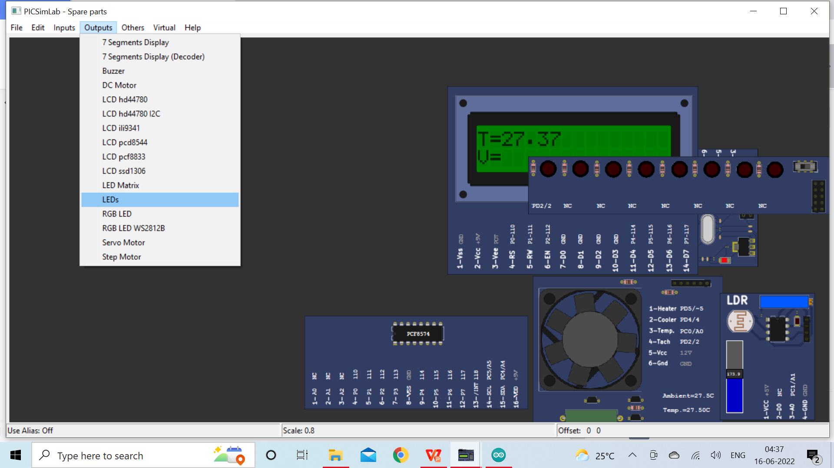
Arduino Simulation
Go to spare parts
select outputs
select LEDs
right click to get LED
Notes:
Inexpensive - Arduino boards are relatively inexpensive compared to other microcontroller platforms. The least expensive version of the Arduino module can be assembled by hand, and even the pre-assembled Arduino modules cost less than $50
Cross-platform - The Arduino Software (IDE) runs on Windows, Macintosh OSX, and Linux operating systems. Most microcontroller systems are limited to Windows.
Simple, clear programming environment - The Arduino Software (IDE) is easy-to-use for beginners, yet flexible enough for advanced users to take advantage of as well. For teachers, it's conveniently based on the Processing programming environment, so students learning to program in that environment will be familiar with how the Arduino IDE works.
Open source and extensible software - The Arduino software is published as open source tools, available for extension by experienced programmers. The language can be expanded through C++ libraries, and people wanting to understand the technical details can make the leap from Arduino to the AVR C programming language on which it's based. Similarly, you can add AVR-C code directly into your Arduino programs if you want to.
Open source and extensible hardware - The plans of the Arduino boards are published under a Creative Commons license, so experienced circuit designers can make their own version of the module, extending it and improving it. Even relatively inexperienced users can build the breadboard version of the module in order to understand how it works and save money.

Slide 29
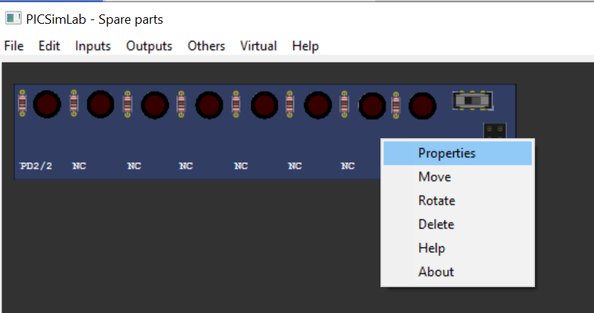
Arduino Simulation
Right click on LED , select Properties
Notes:
Inexpensive - Arduino boards are relatively inexpensive compared to other microcontroller platforms. The least expensive version of the Arduino module can be assembled by hand, and even the pre-assembled Arduino modules cost less than $50
Cross-platform - The Arduino Software (IDE) runs on Windows, Macintosh OSX, and Linux operating systems. Most microcontroller systems are limited to Windows.
Simple, clear programming environment - The Arduino Software (IDE) is easy-to-use for beginners, yet flexible enough for advanced users to take advantage of as well. For teachers, it's conveniently based on the Processing programming environment, so students learning to program in that environment will be familiar with how the Arduino IDE works.
Open source and extensible software - The Arduino software is published as open source tools, available for extension by experienced programmers. The language can be expanded through C++ libraries, and people wanting to understand the technical details can make the leap from Arduino to the AVR C programming language on which it's based. Similarly, you can add AVR-C code directly into your Arduino programs if you want to.
Open source and extensible hardware - The plans of the Arduino boards are published under a Creative Commons license, so experienced circuit designers can make their own version of the module, extending it and improving it. Even relatively inexperienced users can build the breadboard version of the module in order to understand how it works and save money.

Slide 30
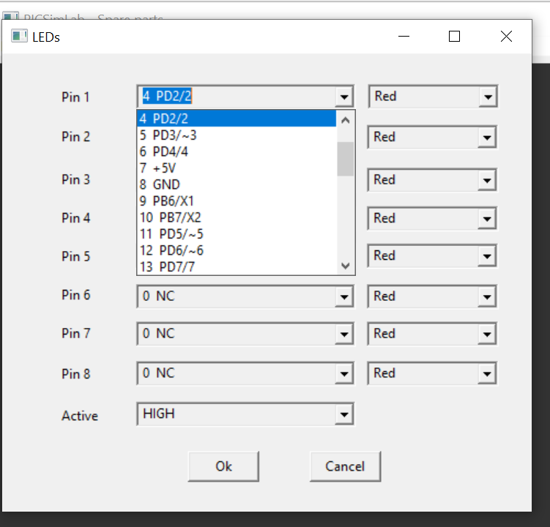
Arduino Simulation
Select Pin2
And Click on Ok
Notes:
Inexpensive - Arduino boards are relatively inexpensive compared to other microcontroller platforms. The least expensive version of the Arduino module can be assembled by hand, and even the pre-assembled Arduino modules cost less than $50
Cross-platform - The Arduino Software (IDE) runs on Windows, Macintosh OSX, and Linux operating systems. Most microcontroller systems are limited to Windows.
Simple, clear programming environment - The Arduino Software (IDE) is easy-to-use for beginners, yet flexible enough for advanced users to take advantage of as well. For teachers, it's conveniently based on the Processing programming environment, so students learning to program in that environment will be familiar with how the Arduino IDE works.
Open source and extensible software - The Arduino software is published as open source tools, available for extension by experienced programmers. The language can be expanded through C++ libraries, and people wanting to understand the technical details can make the leap from Arduino to the AVR C programming language on which it's based. Similarly, you can add AVR-C code directly into your Arduino programs if you want to.
Open source and extensible hardware - The plans of the Arduino boards are published under a Creative Commons license, so experienced circuit designers can make their own version of the module, extending it and improving it. Even relatively inexperienced users can build the breadboard version of the module in order to understand how it works and save money.

Slide 31
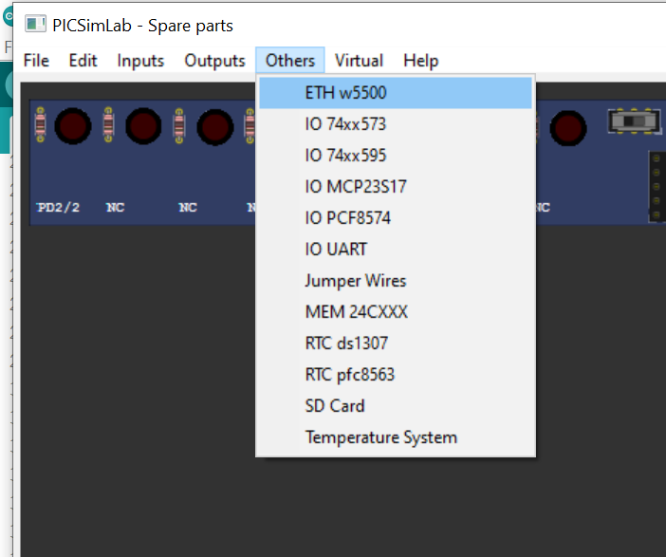
Arduino Simulation
Select others , select
ETH w5500.
And right click
Notes:
Inexpensive - Arduino boards are relatively inexpensive compared to other microcontroller platforms. The least expensive version of the Arduino module can be assembled by hand, and even the pre-assembled Arduino modules cost less than $50
Cross-platform - The Arduino Software (IDE) runs on Windows, Macintosh OSX, and Linux operating systems. Most microcontroller systems are limited to Windows.
Simple, clear programming environment - The Arduino Software (IDE) is easy-to-use for beginners, yet flexible enough for advanced users to take advantage of as well. For teachers, it's conveniently based on the Processing programming environment, so students learning to program in that environment will be familiar with how the Arduino IDE works.
Open source and extensible software - The Arduino software is published as open source tools, available for extension by experienced programmers. The language can be expanded through C++ libraries, and people wanting to understand the technical details can make the leap from Arduino to the AVR C programming language on which it's based. Similarly, you can add AVR-C code directly into your Arduino programs if you want to.
Open source and extensible hardware - The plans of the Arduino boards are published under a Creative Commons license, so experienced circuit designers can make their own version of the module, extending it and improving it. Even relatively inexperienced users can build the breadboard version of the module in order to understand how it works and save money.

Slide 32
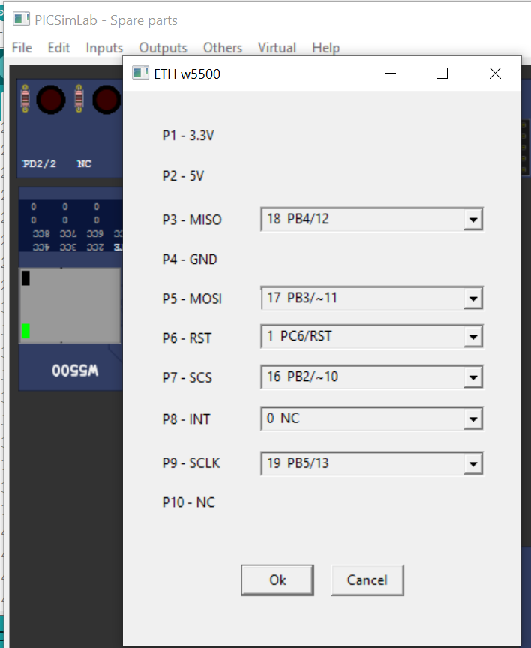
Arduino Simulation
select GPIO pins for ethernet
sheild
Click on OK
Notes:
Inexpensive - Arduino boards are relatively inexpensive compared to other microcontroller platforms. The least expensive version of the Arduino module can be assembled by hand, and even the pre-assembled Arduino modules cost less than $50
Cross-platform - The Arduino Software (IDE) runs on Windows, Macintosh OSX, and Linux operating systems. Most microcontroller systems are limited to Windows.
Simple, clear programming environment - The Arduino Software (IDE) is easy-to-use for beginners, yet flexible enough for advanced users to take advantage of as well. For teachers, it's conveniently based on the Processing programming environment, so students learning to program in that environment will be familiar with how the Arduino IDE works.
Open source and extensible software - The Arduino software is published as open source tools, available for extension by experienced programmers. The language can be expanded through C++ libraries, and people wanting to understand the technical details can make the leap from Arduino to the AVR C programming language on which it's based. Similarly, you can add AVR-C code directly into your Arduino programs if you want to.
Open source and extensible hardware - The plans of the Arduino boards are published under a Creative Commons license, so experienced circuit designers can make their own version of the module, extending it and improving it. Even relatively inexperienced users can build the breadboard version of the module in order to understand how it works and save money.

Slide 33
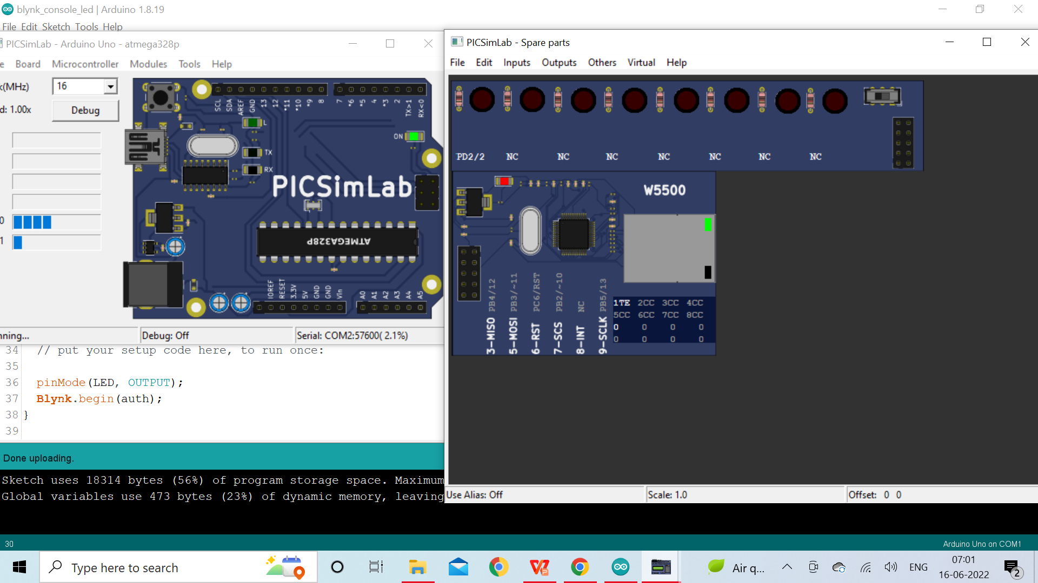
Arduino Simulation
Setup is ready upload the code from arduino ide
Notes:
Inexpensive - Arduino boards are relatively inexpensive compared to other microcontroller platforms. The least expensive version of the Arduino module can be assembled by hand, and even the pre-assembled Arduino modules cost less than $50
Cross-platform - The Arduino Software (IDE) runs on Windows, Macintosh OSX, and Linux operating systems. Most microcontroller systems are limited to Windows.
Simple, clear programming environment - The Arduino Software (IDE) is easy-to-use for beginners, yet flexible enough for advanced users to take advantage of as well. For teachers, it's conveniently based on the Processing programming environment, so students learning to program in that environment will be familiar with how the Arduino IDE works.
Open source and extensible software - The Arduino software is published as open source tools, available for extension by experienced programmers. The language can be expanded through C++ libraries, and people wanting to understand the technical details can make the leap from Arduino to the AVR C programming language on which it's based. Similarly, you can add AVR-C code directly into your Arduino programs if you want to.
Open source and extensible hardware - The plans of the Arduino boards are published under a Creative Commons license, so experienced circuit designers can make their own version of the module, extending it and improving it. Even relatively inexperienced users can build the breadboard version of the module in order to understand how it works and save money.

Slide 34
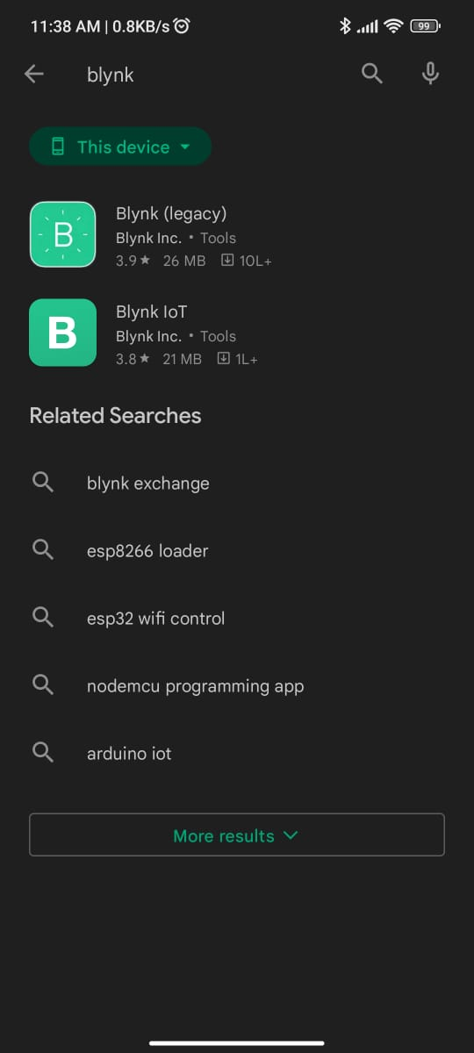
Arduino Set up in mobile
Open playstore and search for Blynk
and download Blynk iot app.
Notes:
Inexpensive - Arduino boards are relatively inexpensive compared to other microcontroller platforms. The least expensive version of the Arduino module can be assembled by hand, and even the pre-assembled Arduino modules cost less than $50
Cross-platform - The Arduino Software (IDE) runs on Windows, Macintosh OSX, and Linux operating systems. Most microcontroller systems are limited to Windows.
Simple, clear programming environment - The Arduino Software (IDE) is easy-to-use for beginners, yet flexible enough for advanced users to take advantage of as well. For teachers, it's conveniently based on the Processing programming environment, so students learning to program in that environment will be familiar with how the Arduino IDE works.
Open source and extensible software - The Arduino software is published as open source tools, available for extension by experienced programmers. The language can be expanded through C++ libraries, and people wanting to understand the technical details can make the leap from Arduino to the AVR C programming language on which it's based. Similarly, you can add AVR-C code directly into your Arduino programs if you want to.
Open source and extensible hardware - The plans of the Arduino boards are published under a Creative Commons license, so experienced circuit designers can make their own version of the module, extending it and improving it. Even relatively inexperienced users can build the breadboard version of the module in order to understand how it works and save money.

Slide 35
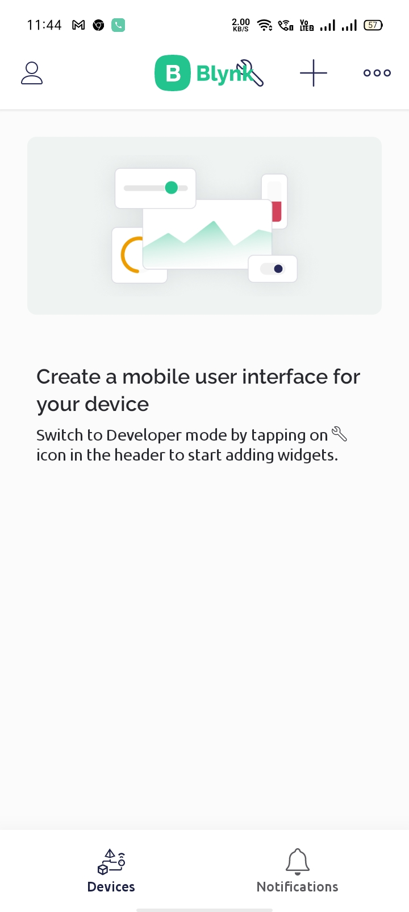
Arduino Set up in mobile
Open Blynk iot app and login
with same mail-id as in blynk console.
Tap on settings icon to enter in to
devloper mode to add widgets.
Notes:
Inexpensive - Arduino boards are relatively inexpensive compared to other microcontroller platforms. The least expensive version of the Arduino module can be assembled by hand, and even the pre-assembled Arduino modules cost less than $50
Cross-platform - The Arduino Software (IDE) runs on Windows, Macintosh OSX, and Linux operating systems. Most microcontroller systems are limited to Windows.
Simple, clear programming environment - The Arduino Software (IDE) is easy-to-use for beginners, yet flexible enough for advanced users to take advantage of as well. For teachers, it's conveniently based on the Processing programming environment, so students learning to program in that environment will be familiar with how the Arduino IDE works.
Open source and extensible software - The Arduino software is published as open source tools, available for extension by experienced programmers. The language can be expanded through C++ libraries, and people wanting to understand the technical details can make the leap from Arduino to the AVR C programming language on which it's based. Similarly, you can add AVR-C code directly into your Arduino programs if you want to.
Open source and extensible hardware - The plans of the Arduino boards are published under a Creative Commons license, so experienced circuit designers can make their own version of the module, extending it and improving it. Even relatively inexperienced users can build the breadboard version of the module in order to understand how it works and save money.

Slide 36

Arduino Set up in mobile
tap on icon to
add widgets
Notes:
Inexpensive - Arduino boards are relatively inexpensive compared to other microcontroller platforms. The least expensive version of the Arduino module can be assembled by hand, and even the pre-assembled Arduino modules cost less than $50
Cross-platform - The Arduino Software (IDE) runs on Windows, Macintosh OSX, and Linux operating systems. Most microcontroller systems are limited to Windows.
Simple, clear programming environment - The Arduino Software (IDE) is easy-to-use for beginners, yet flexible enough for advanced users to take advantage of as well. For teachers, it's conveniently based on the Processing programming environment, so students learning to program in that environment will be familiar with how the Arduino IDE works.
Open source and extensible software - The Arduino software is published as open source tools, available for extension by experienced programmers. The language can be expanded through C++ libraries, and people wanting to understand the technical details can make the leap from Arduino to the AVR C programming language on which it's based. Similarly, you can add AVR-C code directly into your Arduino programs if you want to.
Open source and extensible hardware - The plans of the Arduino boards are published under a Creative Commons license, so experienced circuit designers can make their own version of the module, extending it and improving it. Even relatively inexperienced users can build the breadboard version of the module in order to understand how it works and save money.

Slide 37
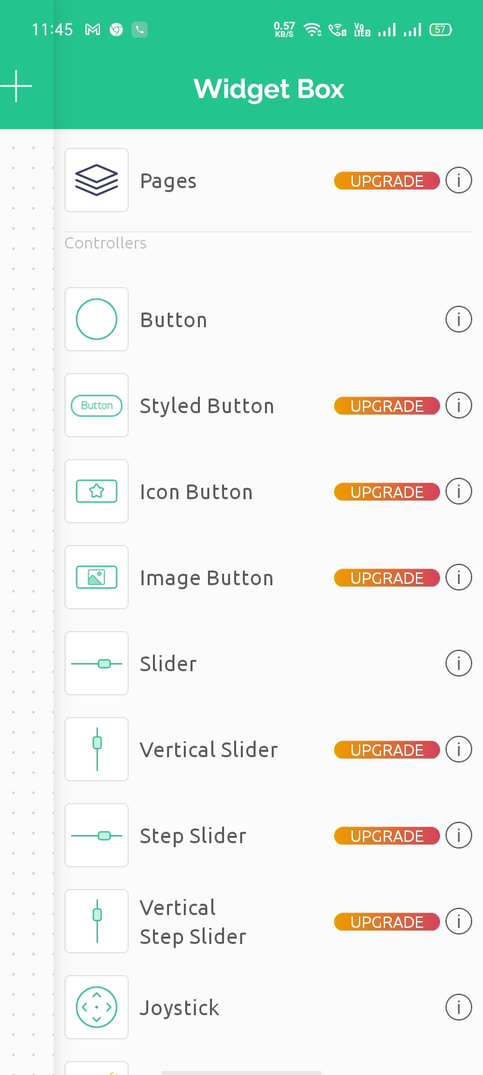
Arduino Set up in mobile
widget box appears
Select Button widget
Notes:
Inexpensive - Arduino boards are relatively inexpensive compared to other microcontroller platforms. The least expensive version of the Arduino module can be assembled by hand, and even the pre-assembled Arduino modules cost less than $50
Cross-platform - The Arduino Software (IDE) runs on Windows, Macintosh OSX, and Linux operating systems. Most microcontroller systems are limited to Windows.
Simple, clear programming environment - The Arduino Software (IDE) is easy-to-use for beginners, yet flexible enough for advanced users to take advantage of as well. For teachers, it's conveniently based on the Processing programming environment, so students learning to program in that environment will be familiar with how the Arduino IDE works.
Open source and extensible software - The Arduino software is published as open source tools, available for extension by experienced programmers. The language can be expanded through C++ libraries, and people wanting to understand the technical details can make the leap from Arduino to the AVR C programming language on which it's based. Similarly, you can add AVR-C code directly into your Arduino programs if you want to.
Open source and extensible hardware - The plans of the Arduino boards are published under a Creative Commons license, so experienced circuit designers can make their own version of the module, extending it and improving it. Even relatively inexperienced users can build the breadboard version of the module in order to understand how it works and save money.

Slide 38
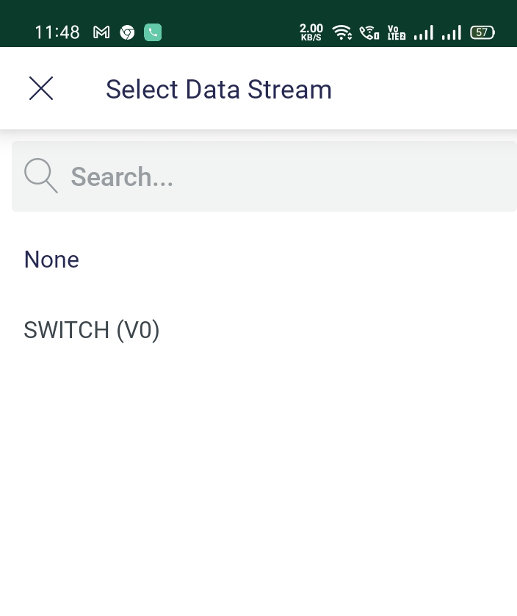
Arduino Set up in mobile
Select the datastream as SWITCH(V0)
go back from developer mode
Notes:
Inexpensive - Arduino boards are relatively inexpensive compared to other microcontroller platforms. The least expensive version of the Arduino module can be assembled by hand, and even the pre-assembled Arduino modules cost less than $50
Cross-platform - The Arduino Software (IDE) runs on Windows, Macintosh OSX, and Linux operating systems. Most microcontroller systems are limited to Windows.
Simple, clear programming environment - The Arduino Software (IDE) is easy-to-use for beginners, yet flexible enough for advanced users to take advantage of as well. For teachers, it's conveniently based on the Processing programming environment, so students learning to program in that environment will be familiar with how the Arduino IDE works.
Open source and extensible software - The Arduino software is published as open source tools, available for extension by experienced programmers. The language can be expanded through C++ libraries, and people wanting to understand the technical details can make the leap from Arduino to the AVR C programming language on which it's based. Similarly, you can add AVR-C code directly into your Arduino programs if you want to.
Open source and extensible hardware - The plans of the Arduino boards are published under a Creative Commons license, so experienced circuit designers can make their own version of the module, extending it and improving it. Even relatively inexperienced users can build the breadboard version of the module in order to understand how it works and save money.

Slide 39
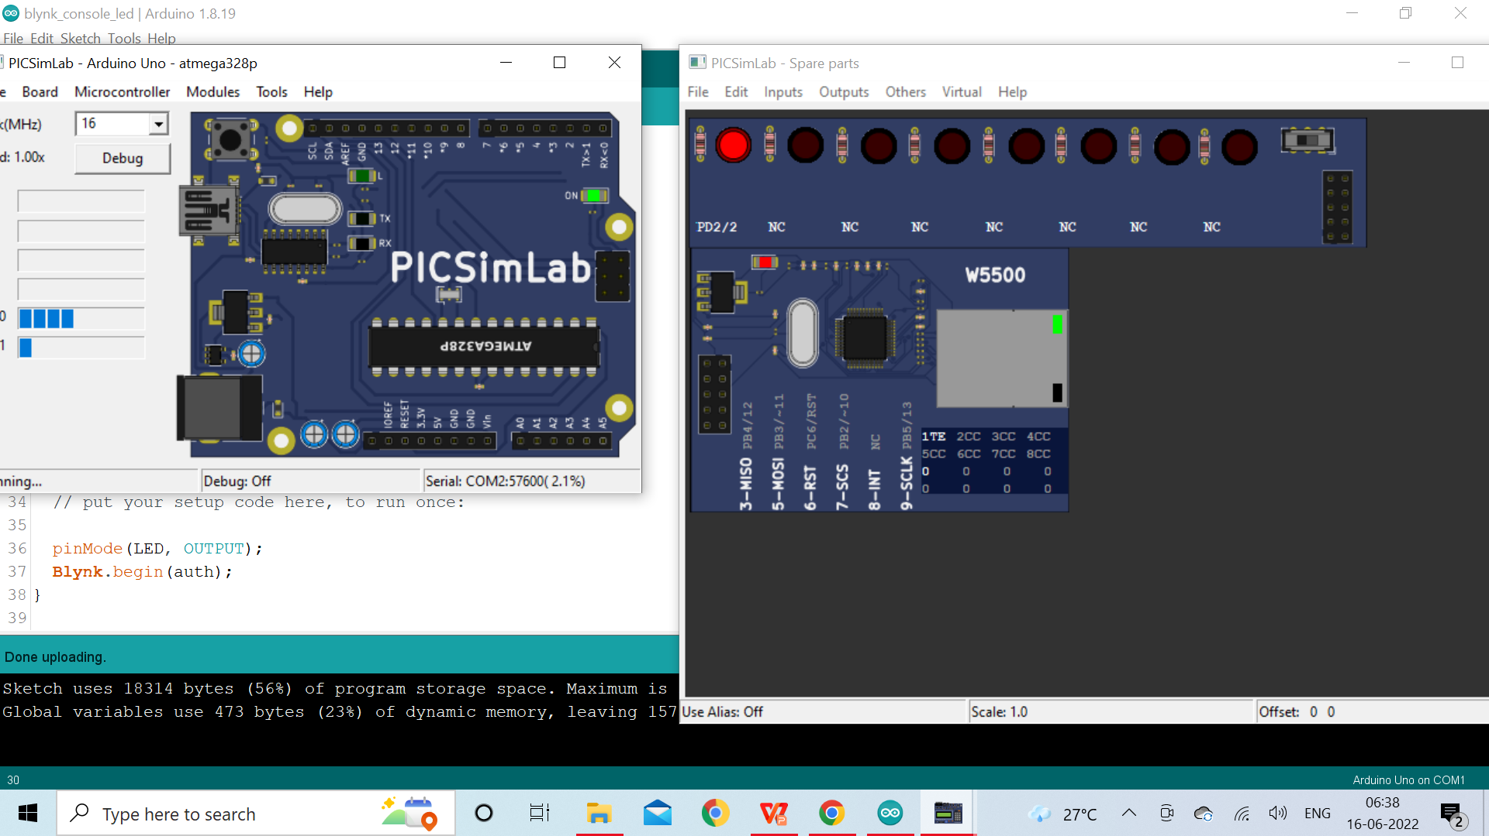
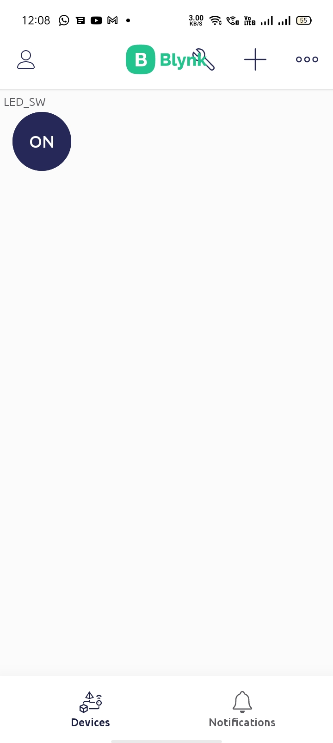
Arduino Set up in mobile
Can control the LED
with LED_sw
widget button
When you turn ON
the button widget
LED turns ON
Notes:
Inexpensive - Arduino boards are relatively inexpensive compared to other microcontroller platforms. The least expensive version of the Arduino module can be assembled by hand, and even the pre-assembled Arduino modules cost less than $50
Cross-platform - The Arduino Software (IDE) runs on Windows, Macintosh OSX, and Linux operating systems. Most microcontroller systems are limited to Windows.
Simple, clear programming environment - The Arduino Software (IDE) is easy-to-use for beginners, yet flexible enough for advanced users to take advantage of as well. For teachers, it's conveniently based on the Processing programming environment, so students learning to program in that environment will be familiar with how the Arduino IDE works.
Open source and extensible software - The Arduino software is published as open source tools, available for extension by experienced programmers. The language can be expanded through C++ libraries, and people wanting to understand the technical details can make the leap from Arduino to the AVR C programming language on which it's based. Similarly, you can add AVR-C code directly into your Arduino programs if you want to.
Open source and extensible hardware - The plans of the Arduino boards are published under a Creative Commons license, so experienced circuit designers can make their own version of the module, extending it and improving it. Even relatively inexperienced users can build the breadboard version of the module in order to understand how it works and save money.

Slide 40
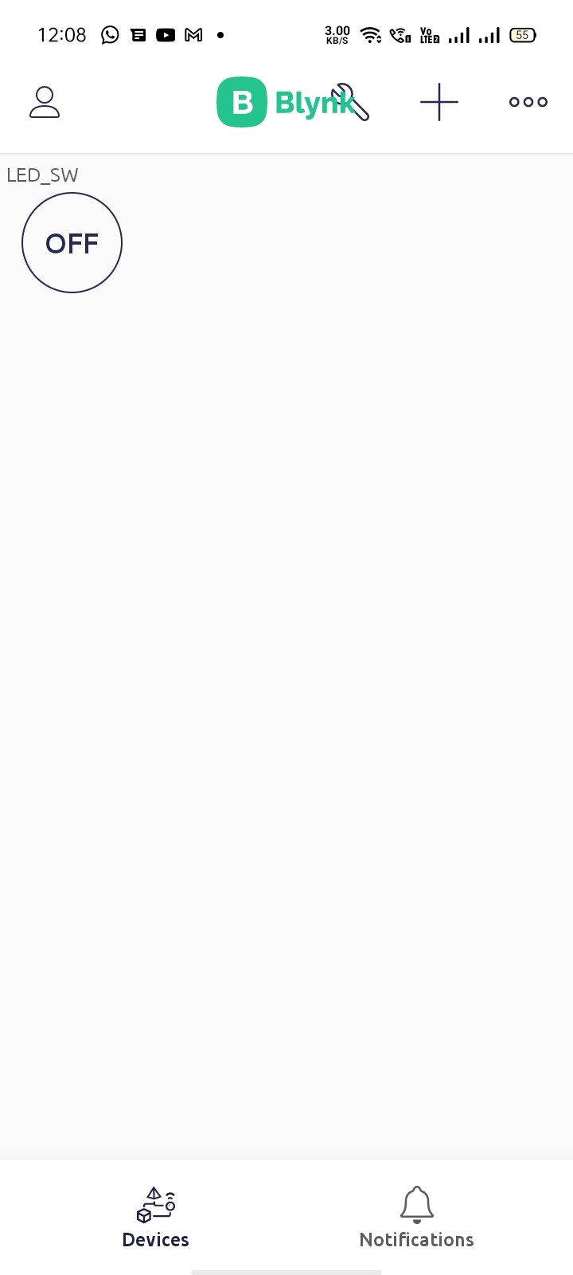
Arduino Set up in mobile
When you turn OFF
the button widget
LED turns OFF
Notes:
Inexpensive - Arduino boards are relatively inexpensive compared to other microcontroller platforms. The least expensive version of the Arduino module can be assembled by hand, and even the pre-assembled Arduino modules cost less than $50
Cross-platform - The Arduino Software (IDE) runs on Windows, Macintosh OSX, and Linux operating systems. Most microcontroller systems are limited to Windows.
Simple, clear programming environment - The Arduino Software (IDE) is easy-to-use for beginners, yet flexible enough for advanced users to take advantage of as well. For teachers, it's conveniently based on the Processing programming environment, so students learning to program in that environment will be familiar with how the Arduino IDE works.
Open source and extensible software - The Arduino software is published as open source tools, available for extension by experienced programmers. The language can be expanded through C++ libraries, and people wanting to understand the technical details can make the leap from Arduino to the AVR C programming language on which it's based. Similarly, you can add AVR-C code directly into your Arduino programs if you want to.
Open source and extensible hardware - The plans of the Arduino boards are published under a Creative Commons license, so experienced circuit designers can make their own version of the module, extending it and improving it. Even relatively inexperienced users can build the breadboard version of the module in order to understand how it works and save money.

Slide 41
Thank You

